Slide 1
Australian supply & demand

Slide 2
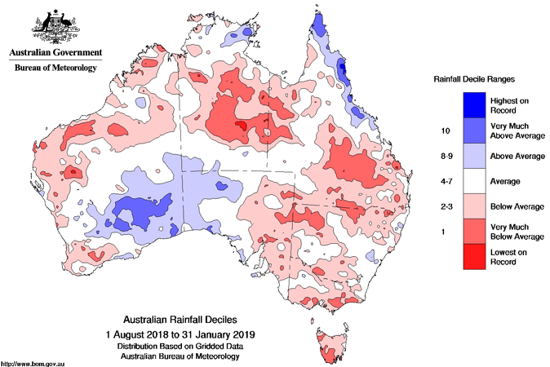
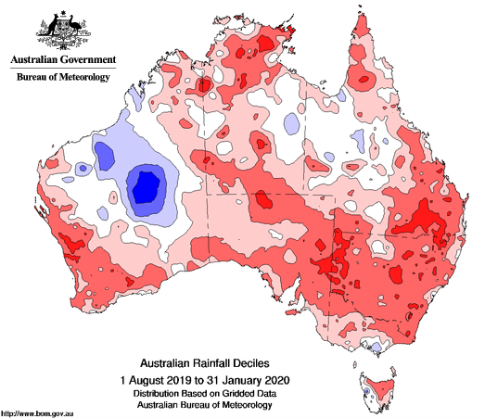
Rainfall Deciles
1 August to 31 January 2019
1 August to 31 January 2020
Source: Bureau of Meteorology

Slide 3
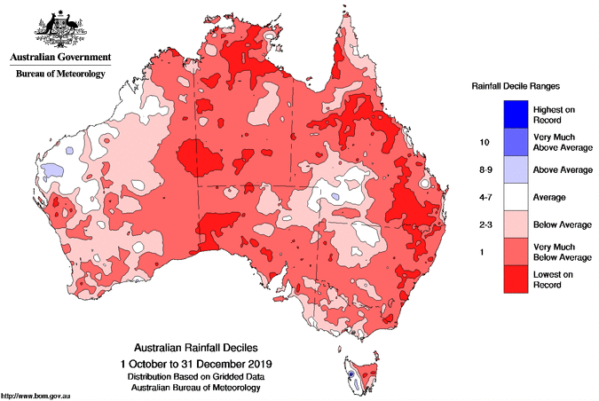
Australian Rainfall Deciles 1 October to 31 December 2019
Source: Bureau of Meteorology

Slide 4
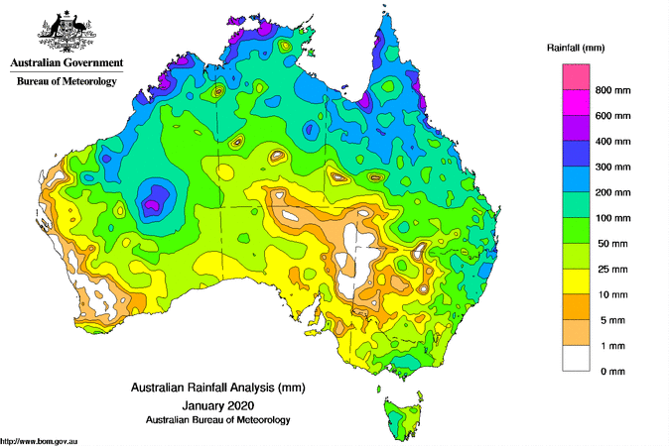
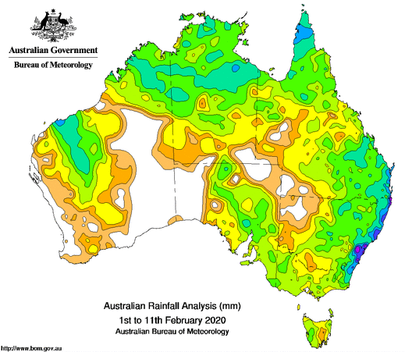
Jan/Feb to date Rainfall totals
Source: Bureau of Meteorology

Slide 5
60%
60%
Source: ACF

Slide 6
QLD/NSW/VIC/SA Feed Grain Surplus/Deficit (Mmt)
Source: ACF

Slide 7
Geelong – Kwinana ASW Values (AUD/mt)
Source: Profarmer

Slide 8
Geelong ASW – BAR1 Spread (AUD/mt)
Source: Profarmer

Slide 9
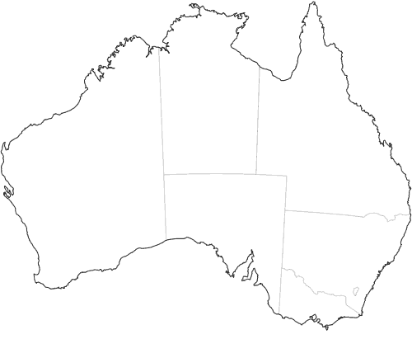
Net Interstate Grain Movements (Mmt)
Source: ACF

Slide 10

2018/19 v 2019/20 Cumulative Interstate Shipments (Mmt)
Source: ACF

Slide 11
Canadian High Protein Wheat Imports (‘000t)
Source: Global Trade Atlas

Slide 12
2019/20 Wheat Supply
Source: ACF

Slide 13
2019/20 Barley Supply
Source: ACF

Slide 14
Cattle on Feed (Million Head)
Source: ABS

Slide 15
CUMULATIVE WHEAT EXPORT PACE (Mmt)
INDONESIA
CHINA
Source: ABS

Slide 16
CUMULATIVE WHEAT EXPORT PACE (Mmt)
JAPAN
PHILIPPINES
Source: ABS

Slide 17
CUMULATIVE BARLEY EXPORT PACE
CHINA
SAUDI ARABIA
Source: ABS

Slide 18
CUMULATIVE BARLEY EXPORT PACE
JAPAN
THAILAND
Source: ABS

Slide 19
Wheat Supply & Demand Balance Sheets
Source: ACF

Slide 20
Barley Supply & Demand Balance Sheets
Source: ACF

Slide 21
Thank you
james.maxwell@australiancropforecasters.com.au
www.cropforecasters.com.au

