Slide 2
GRAINFLOW 1920 POST HARVEST
A long time ago when the earth was green, there was plenty of grain for all sites to be seen.
In this current year gone, the earth’s a bit browner, the amount of grain seen was a bit of a downer…………………….the Story so far……

Slide 3
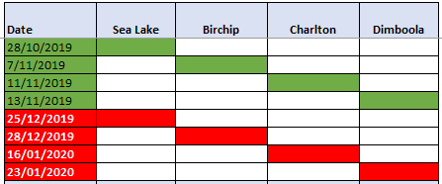
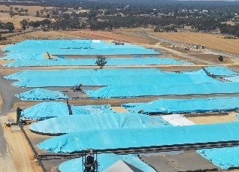
And so it begins…..Harvest
Sea Lake was the first VIC Site to receive, followed by Birchip, Charlton and lastly Dimboola
Harvest ended in the same order, with Dimboola finishing up LH JAN

Slide 4
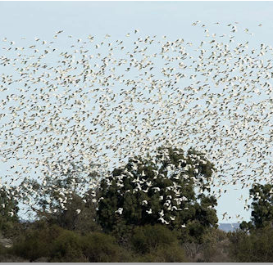
Items of Interest
Significant harvest rail program into NTH NSW
Increased bird activity at Sites due to Bushfires across regions
Strong 3rd party buyer activity
Clear Settled buyers a good inclusion this year, providing growers with secure cash options. Good uptake by growers and buyers
Consistent Quality across all Sites
Good compliance to truck weights

Slide 5
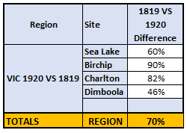
……the comparison otherwise known as… DOT POINT 2 from Colin’s presentation outline - Regional Variability of in take compared to last year
1819
- the year 12 Convict Ships landed in Australia
1920
- the year Australia competed for the first time as a separate Nation at the 1920 Antwerp Olympics
VERSES

Slide 6
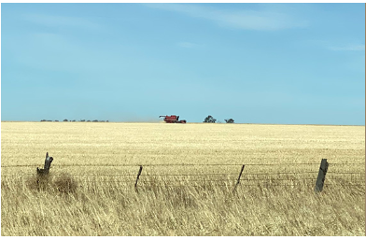
What’s in Warehouse……..

