Slide 1
Grains Industry Association of Victoria
Post Harvest Meeting
Craig Cochrane
Senior Manager, Southern Supply Chain

Slide 2
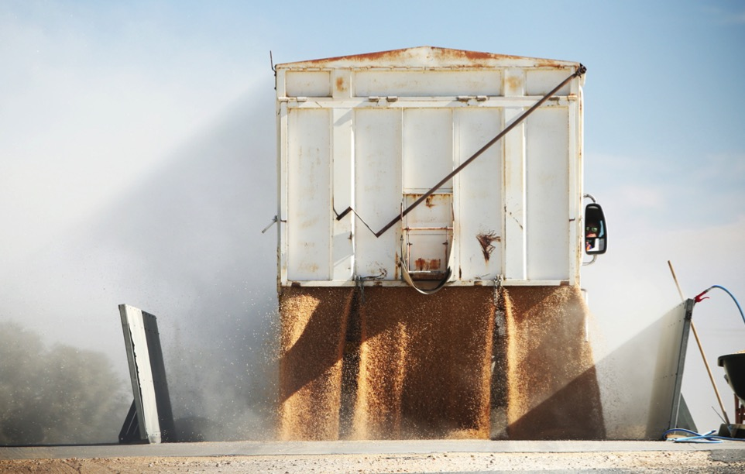
GrainCorp Receivals: 2019/20
GrainCorp Eastern Seaboard intake: 3.5 million tonnes
GrainCorp Victorian region intake: 2.8 million tonnes
Another quiet season for Queensland & Northern New South Wales

Slide 3
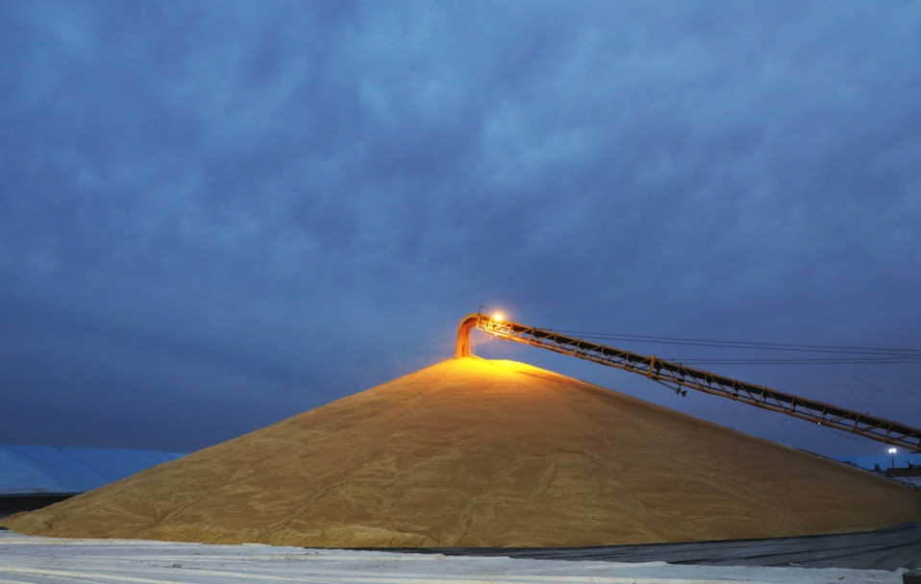
Victorian Receivals: 2019/20
Carpolac, Lillimur, Nhill, Donald, Warracknabeal, Westmere and Rainbow received record numbers
Donald, Rainbow and Warracknabeal each saw an increase of over 100,000mt YOY
Westmere received over 100,000mt for the first time
The ‘North East’ and ‘Northern Mallee’ clusters took just over 150,000mt each
Some growers reported up to 10 tonne hectare crops in the south

Slide 4
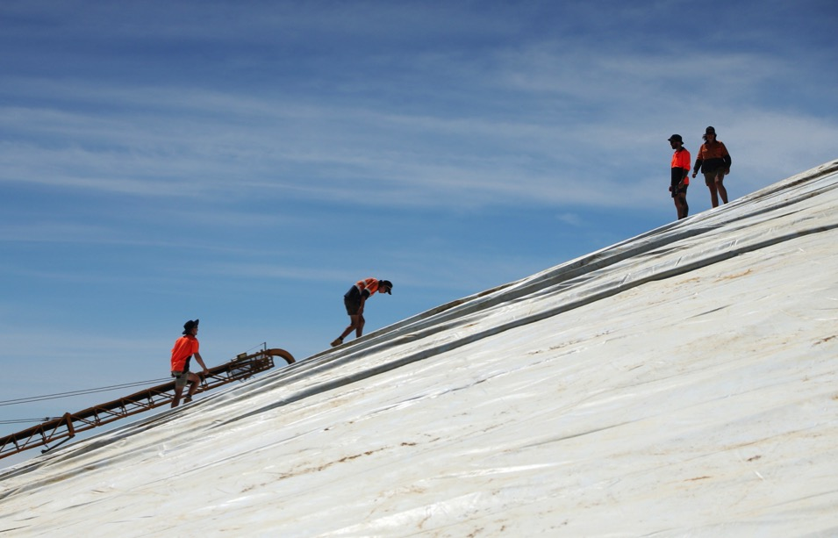
Victoria: Quality and Yields
Average-to-above Canola oil
Spartacus & LaTrobe barley good selection rate
Planet struggled with either TW or protein, and sometimes screenings
ASW1 was the main wheat grade
Excellent yields in WD, Wimmera & Southern Mallee
Other areas ranged very poor to good

Slide 5
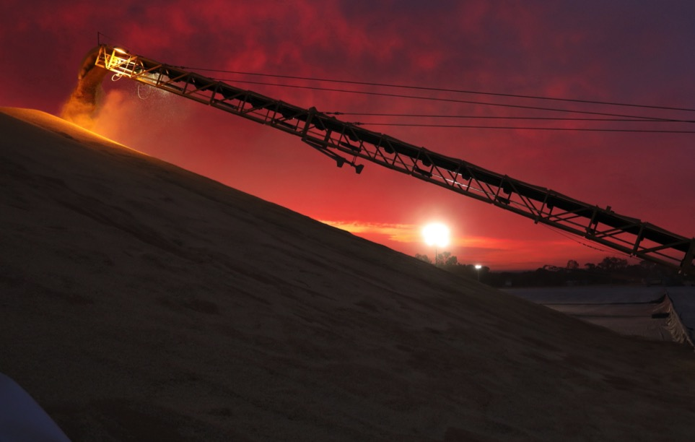
Markets
Northern ECA demand for wheat and barley still dominant
Road, rail and ocean freight working together to meet this market
Canola $ following Euro market
Western Vic growers are stocked up and mindful of inverted market, but not in a hurry to sell

Slide 6
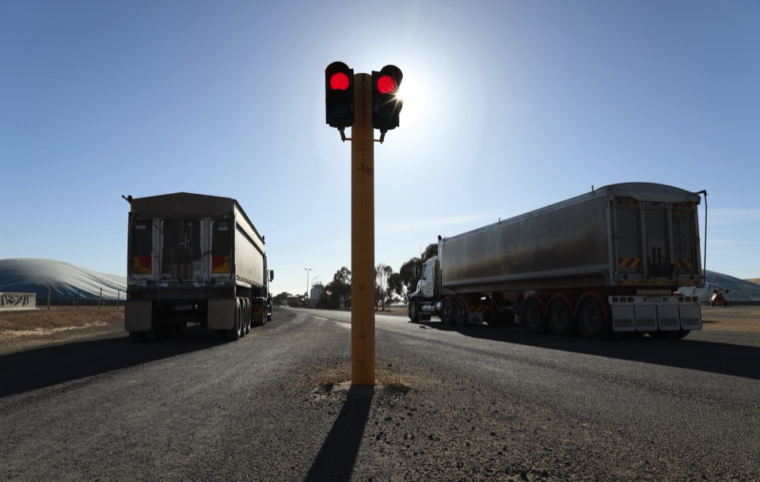
Questions

