Slide 1
Winter Seasonal Outlook
Dale Grey & Jemma Pearl
Bendigo

Slide 2
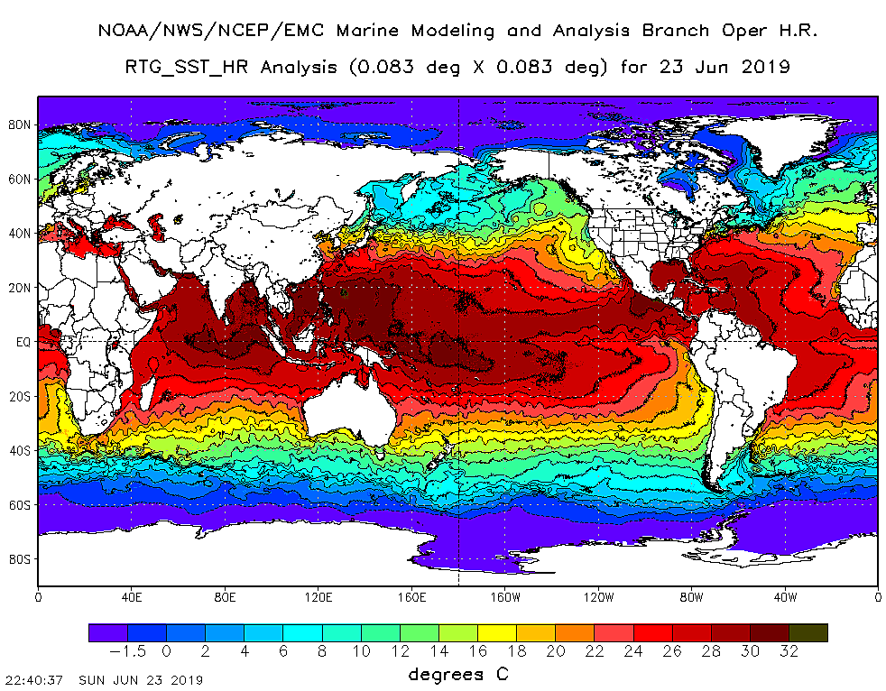
29ºC
24ºC
13ºC
Cyclones over 26.5ºC
Evaporation over 24ºC

Slide 3
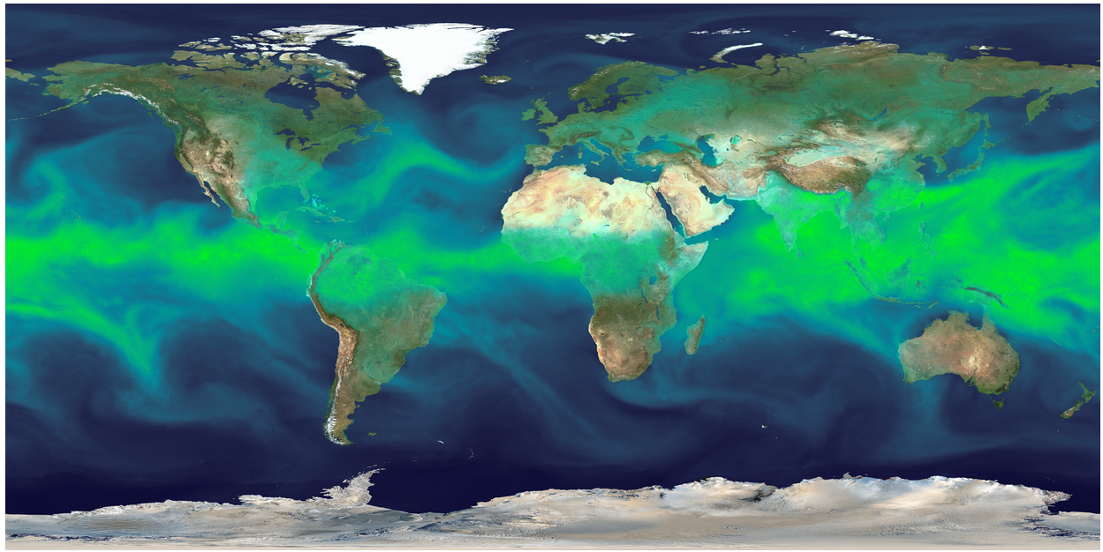
Total Precipitable Water
A measure of how much water is in the air.

Slide 4
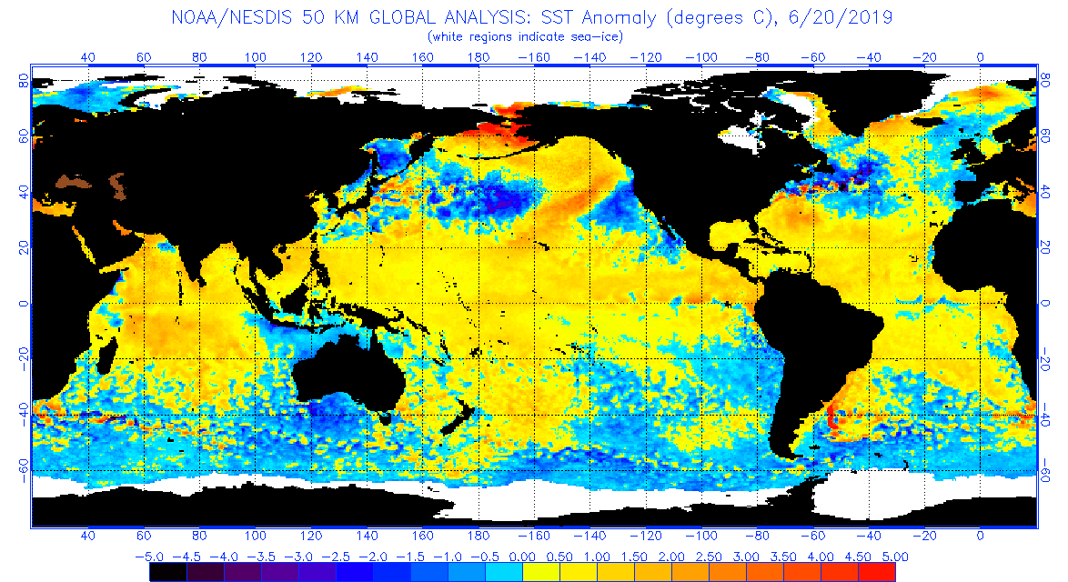
SST anomalies 20th June 2019
NINO 3.4
IOD W
IOD E
NINO 3
NINO3 = +0.42oC, NINO3.4 = +0.62oC, vaguely El Nino
DMI = +0.26ºC, below Positive IOD

Slide 5
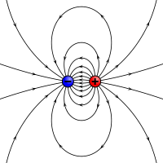
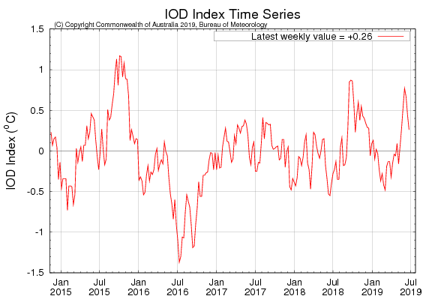
The Dipole Mode Index DMI
+0.26 and falling.
The DMI index is below positive IOD territory.
Worth watching between May-Oct
DMI = West Box Temp – East Box Temp

Slide 6
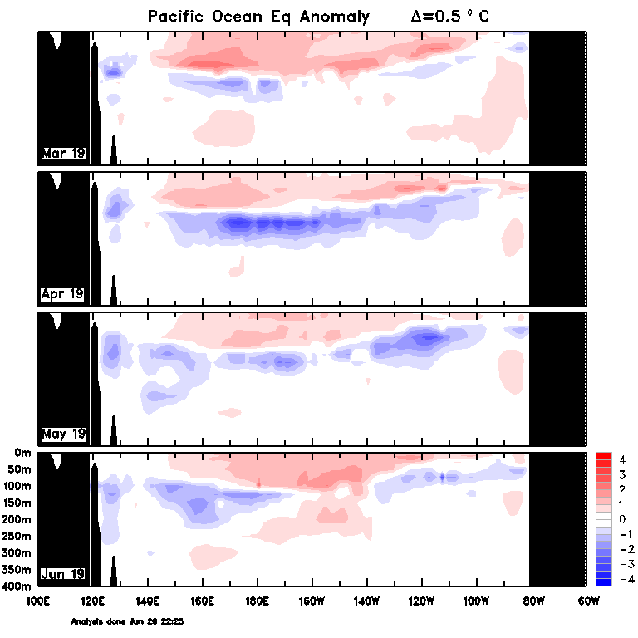
Pacific Equatorial Deep Sea Anomaly
PNG
Ecuador
A bit of reinvigoration of heat to depth but nothing like a proper El Niño

Slide 7
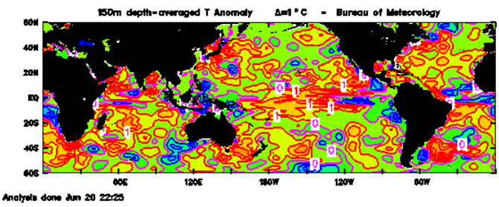
150m Temp Anomaly 20th June 2019
NINO3 = +0.42oC, NINO3.4 = +0.62oC, vaguely El Nino
DMI = +0.26ºC, below Positive IOD

Slide 8
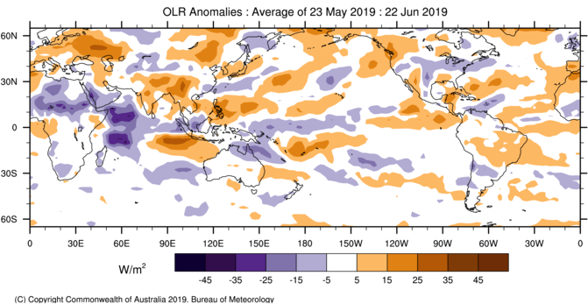
Cloud Anomaly
cloudy
clear
Greater cloud at the International Date Line = El Niño.
A +IOD like cloud pattern off Sumatra.
Coral Sea still OK.

Slide 9
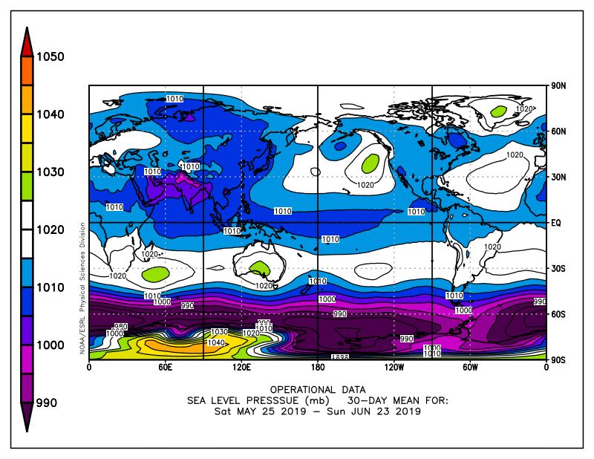
Last 30 days Air Pressure
H
Centre of high pressure at normal winter position on the Bight. Favourable to fronts and lows passing by.

Slide 10
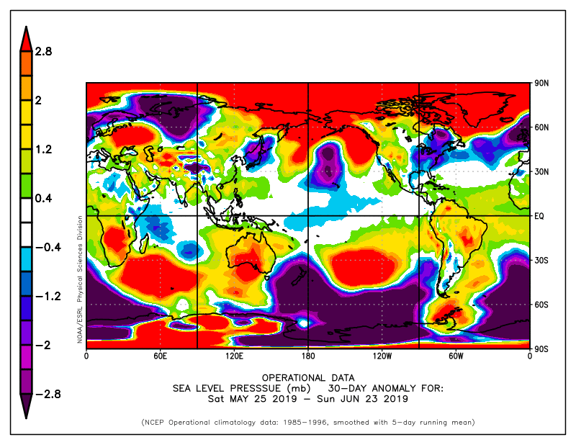
Last 30 days Air Pressure Anomaly
Pressure has been higher over Vic.
And higher in the tropics, not ideal for moisture transport.
Darwin pressure higher, Tahiti slightly higher = SOI slightly negative

Slide 11
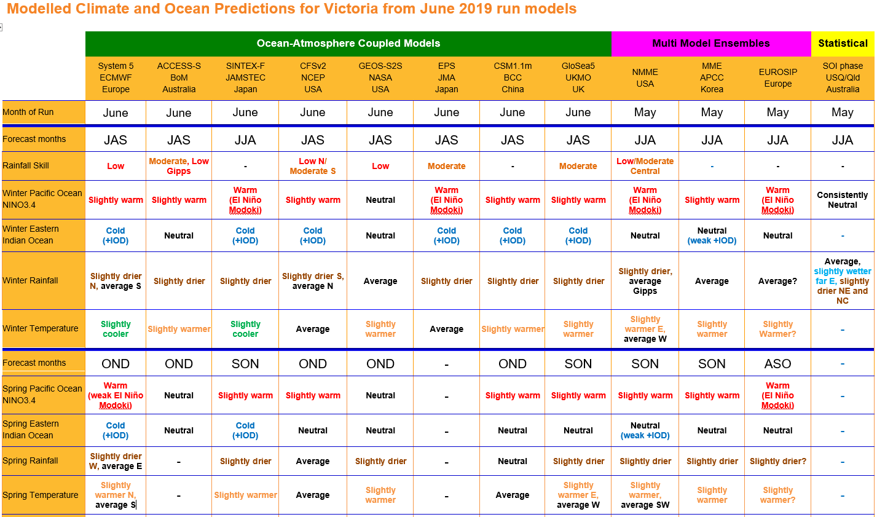
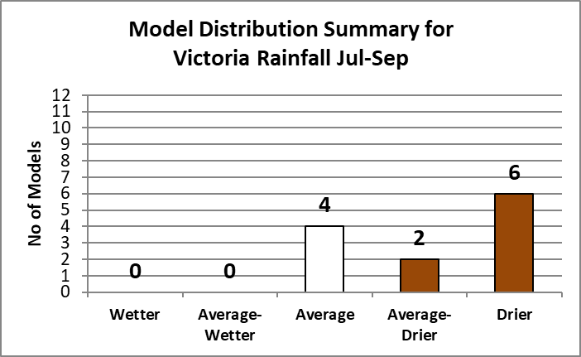
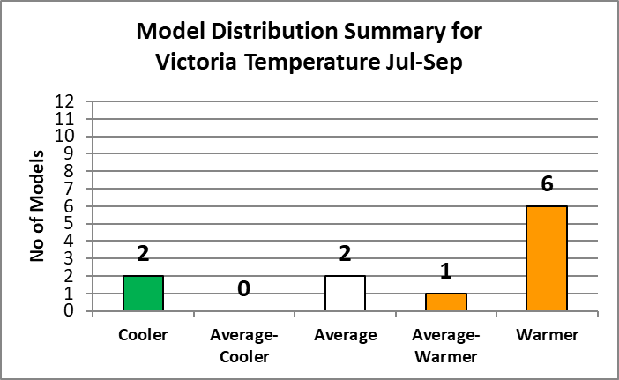
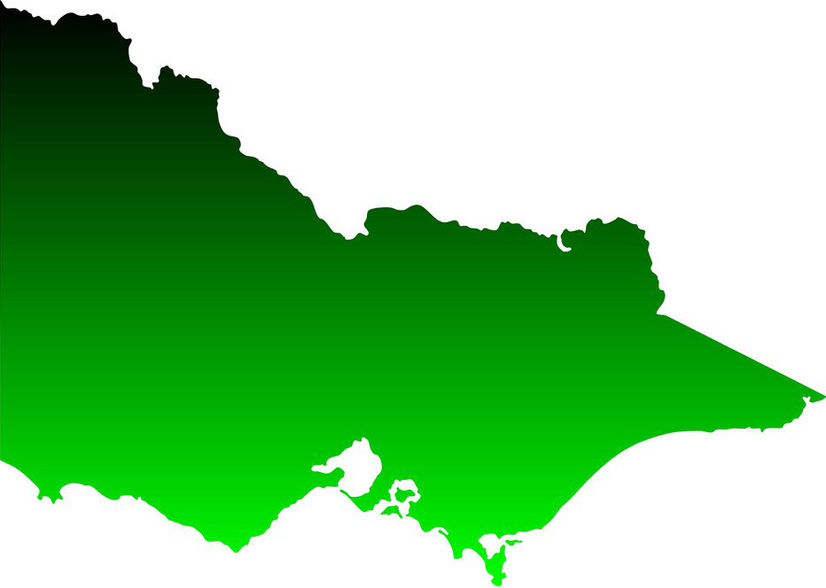
June-Sept
Pacific Ocean- Slightly warm
Indian Ocean- Cold(+IOD)
Rainfall- Slightly drier/average
Temperature- Slightly warmer

Slide 12
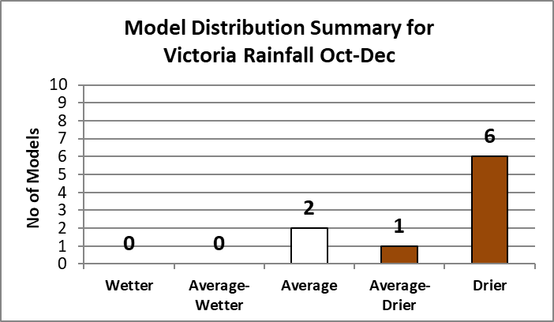
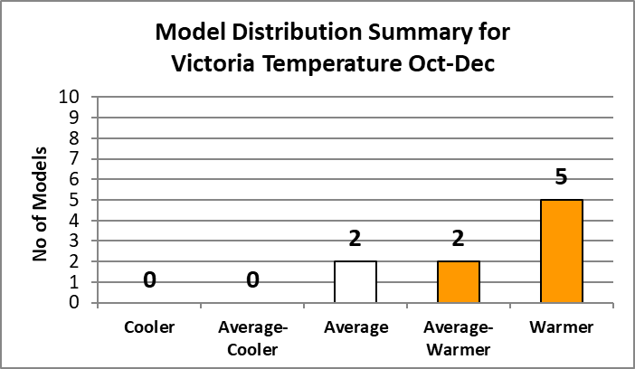
Aug-Dec
Pacific Ocean- Slightly warm
Indian Ocean- Neutral
Rainfall- Slightly drier
Temperature- Slightly warmer/Average

Slide 13
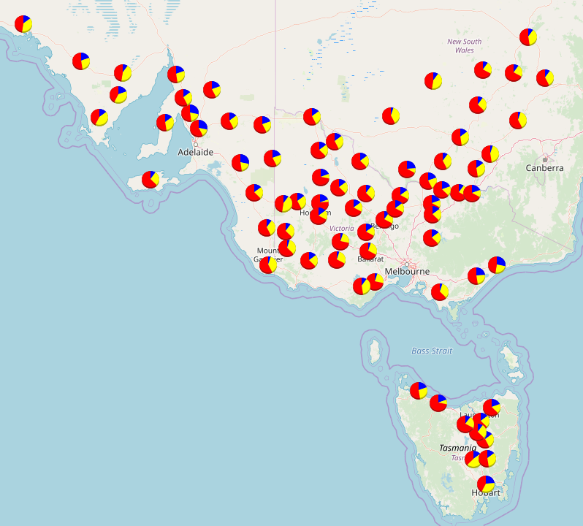
+IOD
Aug-Oct Rainfall
Wetter
Average
Drier

Slide 14
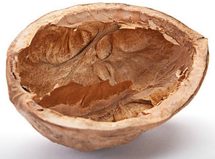
In a Nut Shell
The Pacific Ocean is sort of/sort of not an El Nino. Most models have this state decaying away.
The Indian Ocean is in a +IOD like state and will need to be watched. Most models predict it to hang around for winter, a few into spring.
Models dryer/average rainfall, and warmer temperatures for the next three months
Model skill at this time of the year is improving

Slide 15
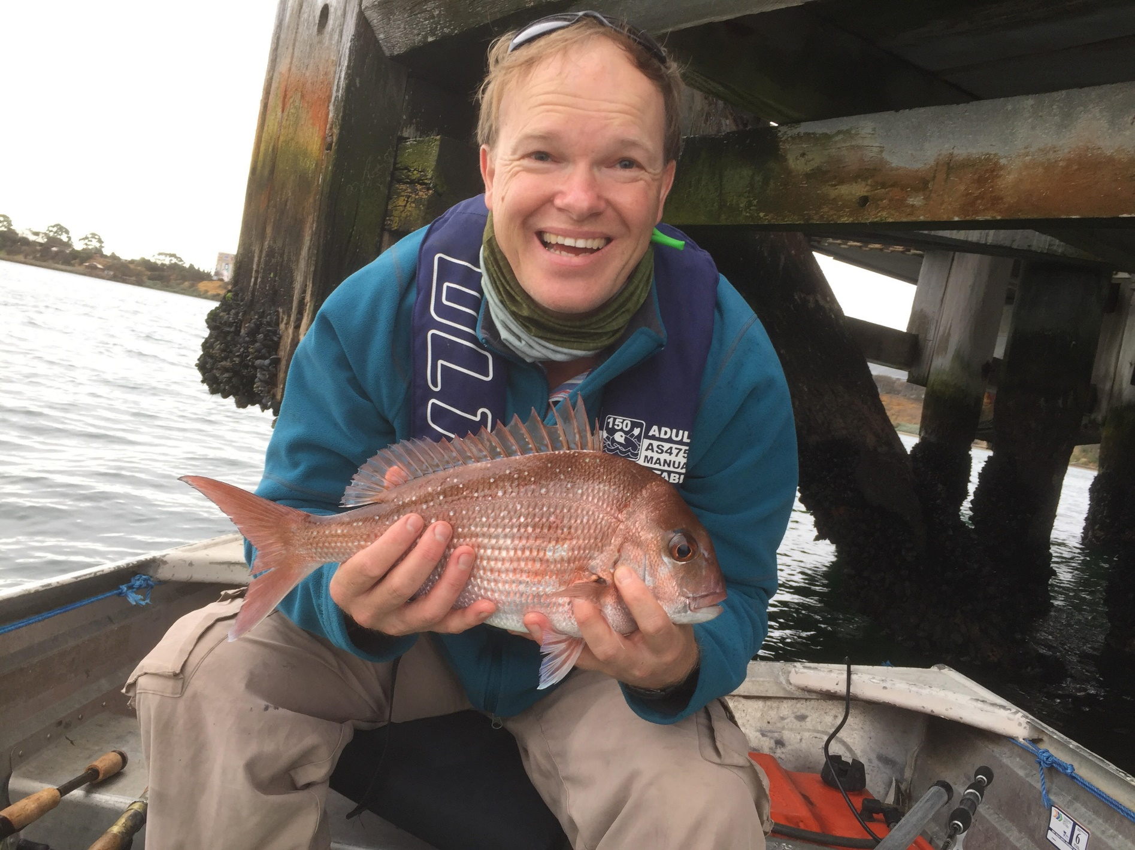
That’s all Folks
37cm Snapper, Corio Bay, Vic, March 2019, photo credit: P. Johnston
Subscribe to “The Break“ newsletters Email the.break@ecodev.vic.gov.au
Or Google “The Break” DEDJTR

