Slide 1
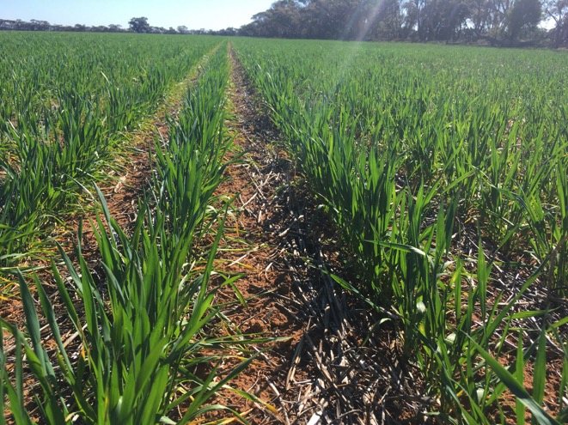
GIAV 2018 Annual Meeting Crop Outlook Panel

Slide 2
Crop Outlook Panel
Michelle Kerr Riordan Grain
Ian Wentworth JK Milling
Bill Donnellon Donnellon Bulk
Brad Cullen Emerald Grain
Richard Wilkens Wilken Storage
Peter Gerhardy Hanlon Enterprises

Slide 3
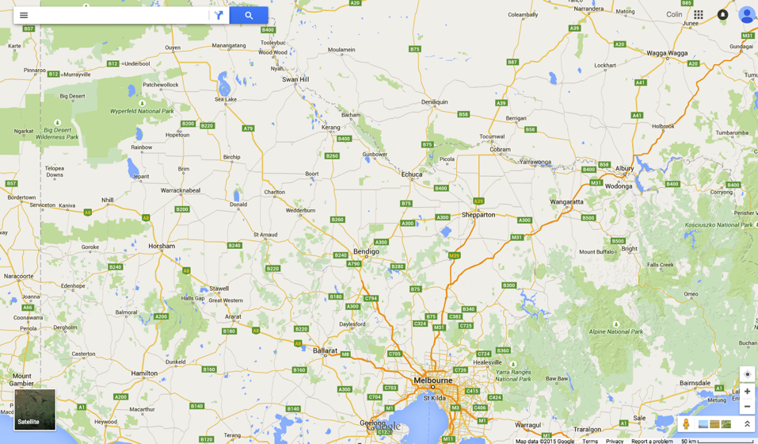
Wimmera

Slide 4
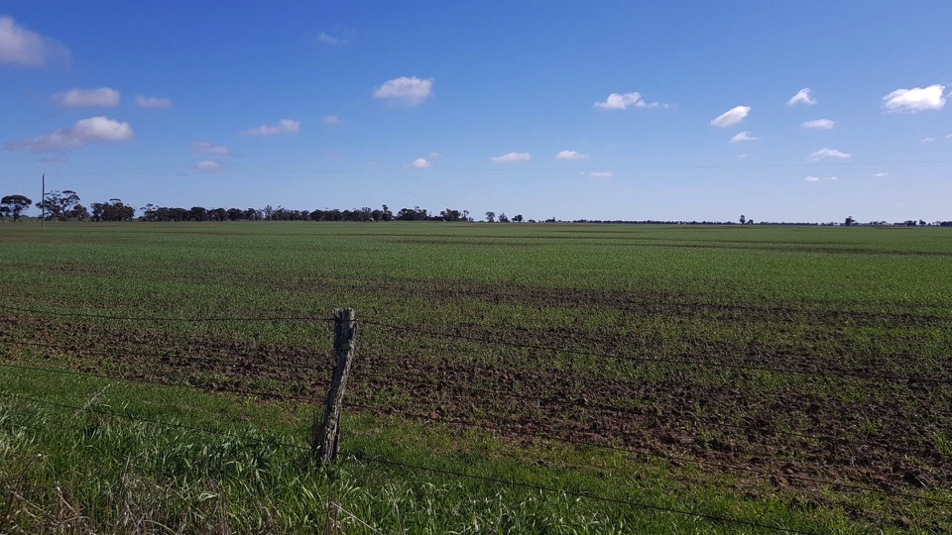

Slide 5
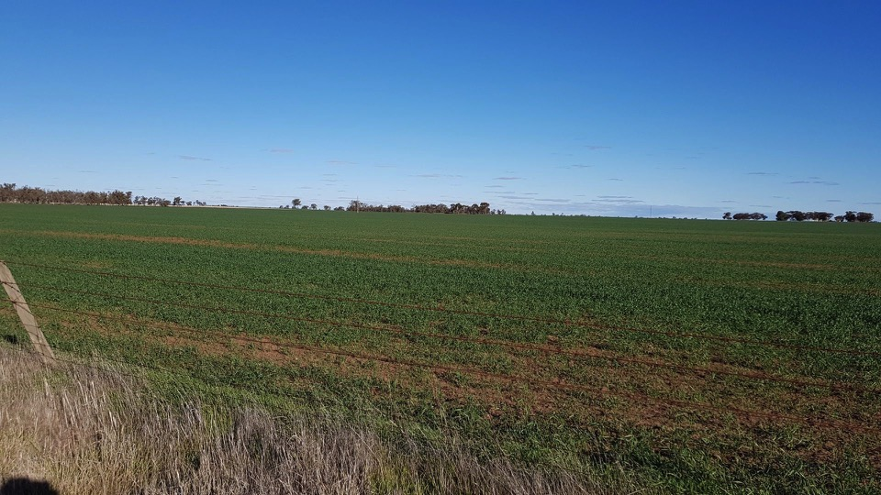

Slide 6
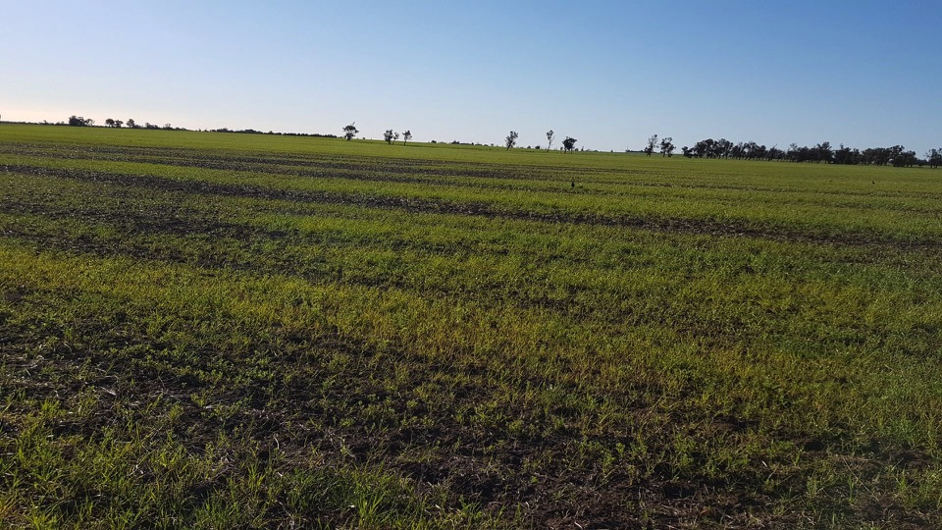

Slide 7
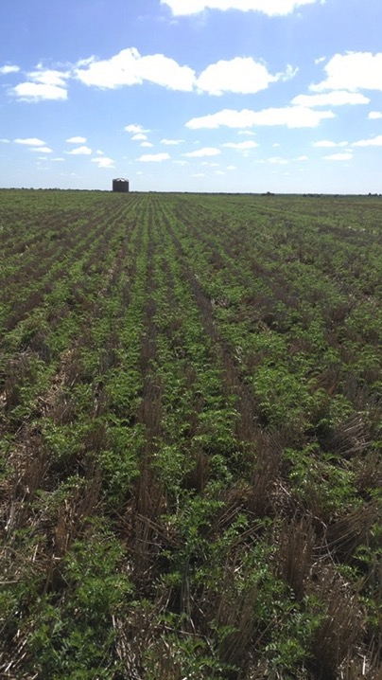

Slide 8
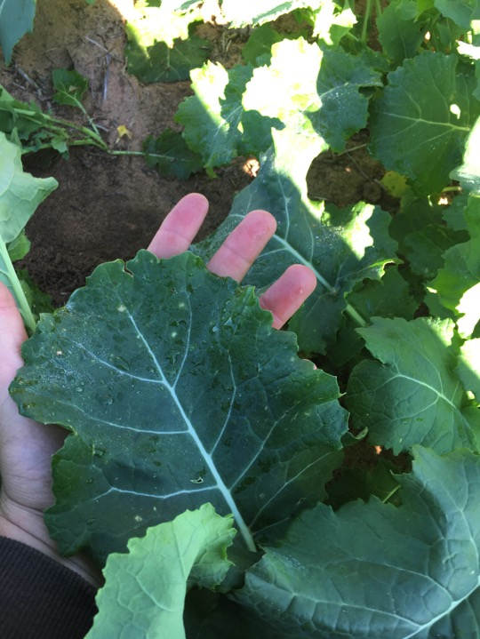

Slide 9
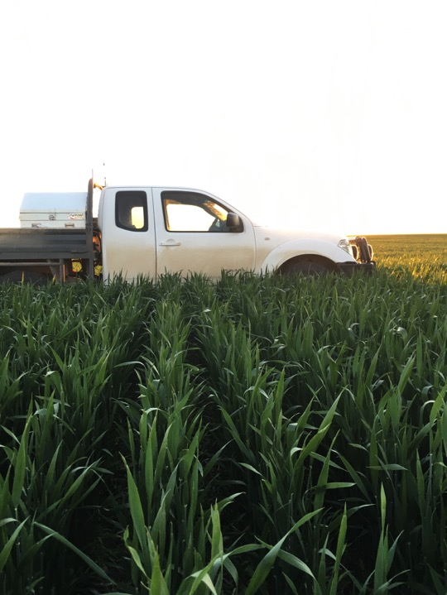

Slide 10
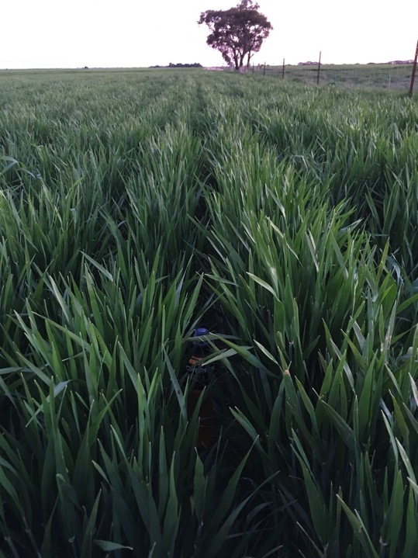

Slide 11
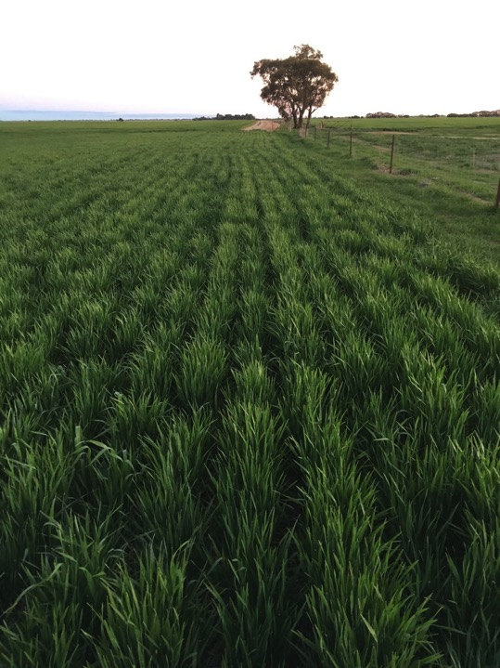

Slide 12
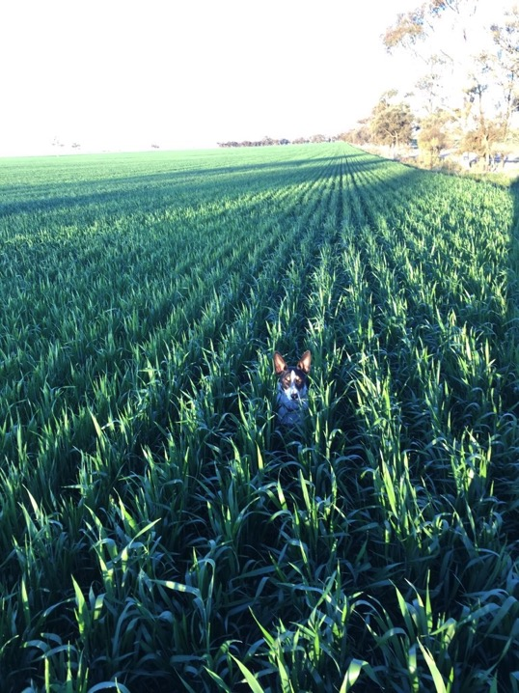

Slide 13
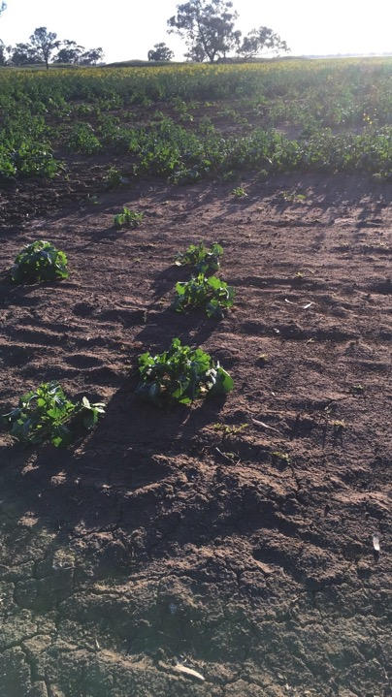

Slide 14
Cut or not to cut
 | Grain | Hay
Yield t/ha | 2 | 4
Price $/t | 320 | 280
Gross $/ha | 640 | 1,120
Harvest cost | 50
Cut |  | 25
Rake |  | 10
Bale/stack |  | 32
Net $/ha | $590 | $1,053

Slide 15
Wimmera

Slide 16
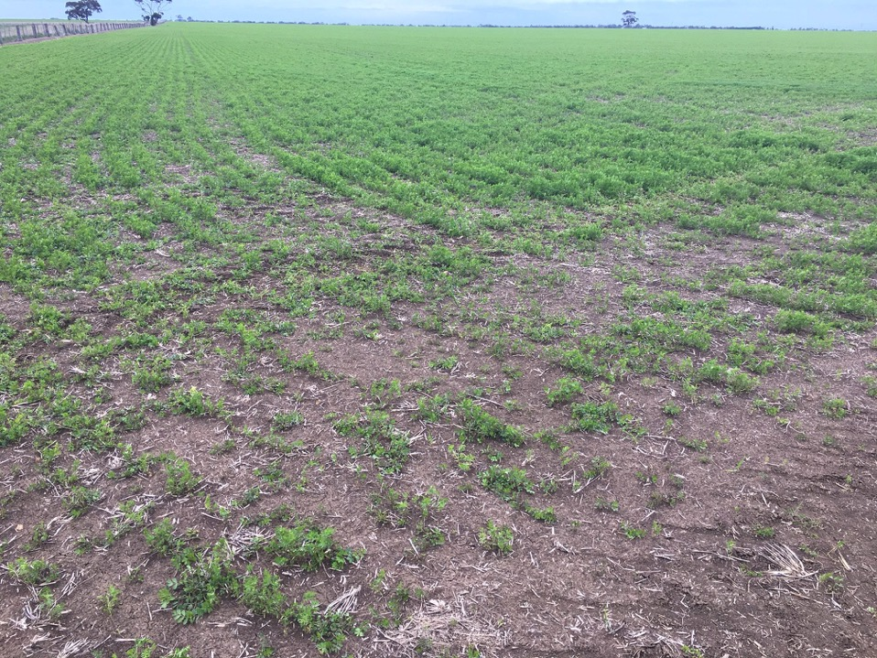

Slide 17
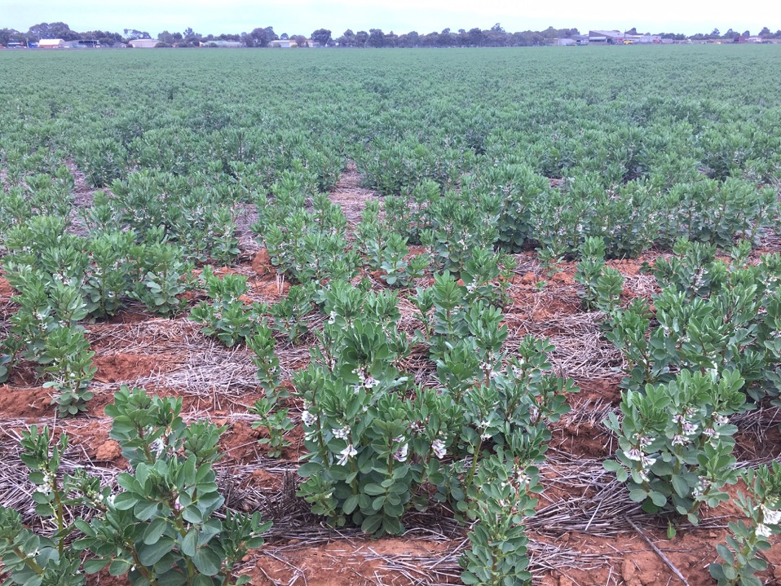

Slide 18
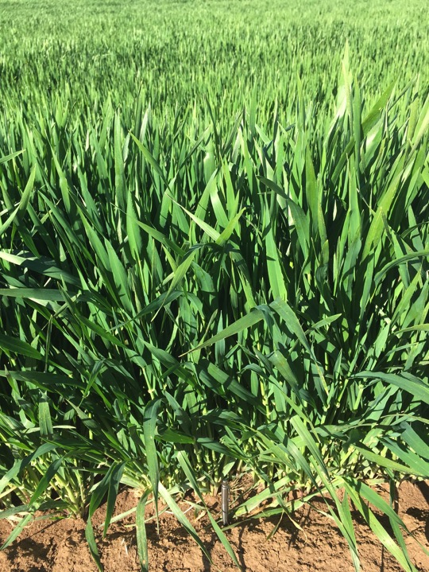

Slide 19
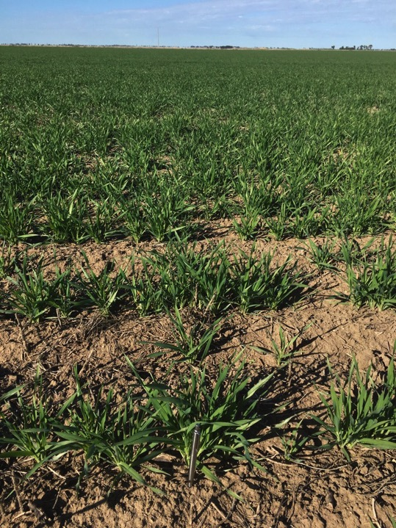

Slide 20
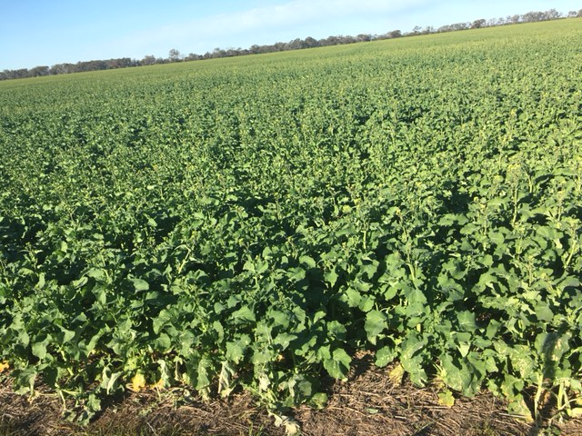

Slide 21
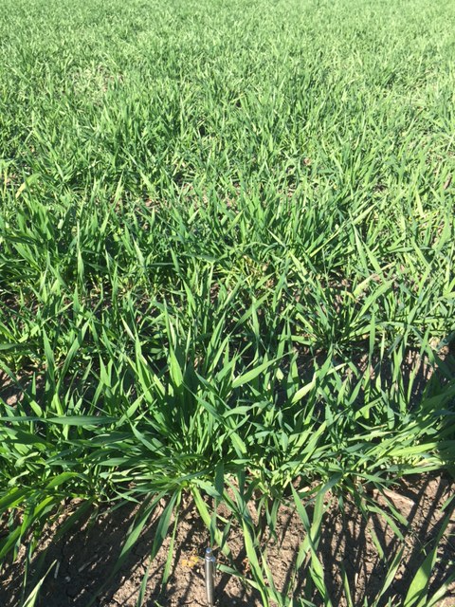

Slide 22
Western District – Sthn Wimmera

Slide 23
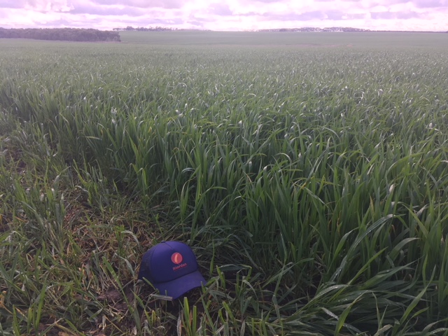

Slide 24
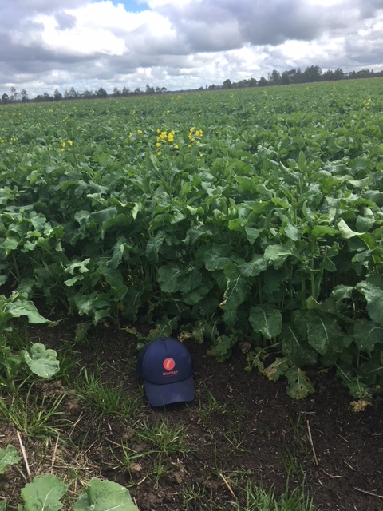

Slide 25
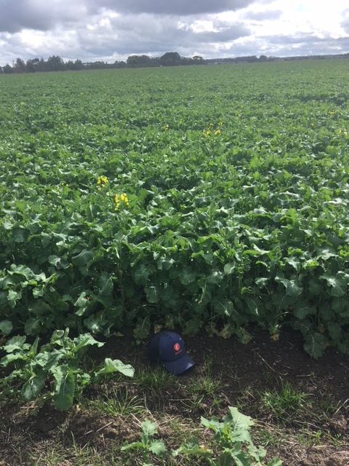

Slide 26
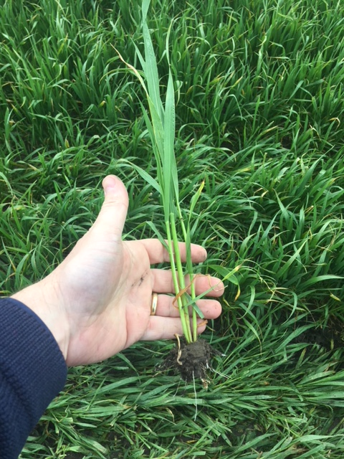

Slide 27
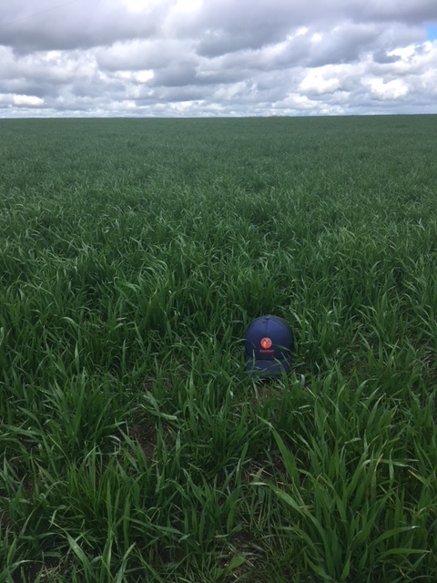

Slide 28
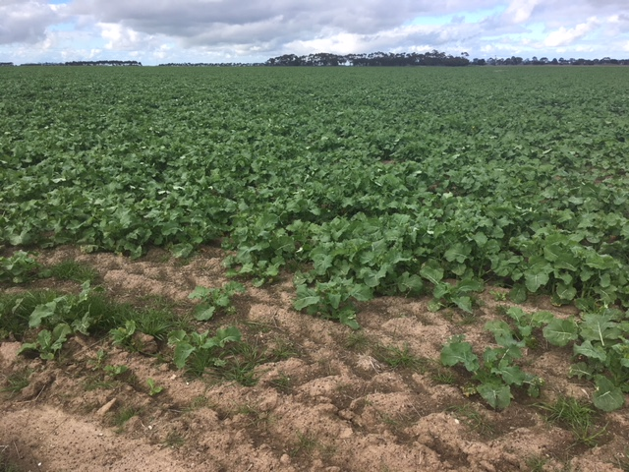

Slide 29
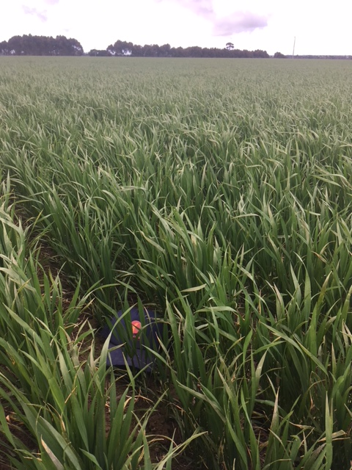

Slide 30
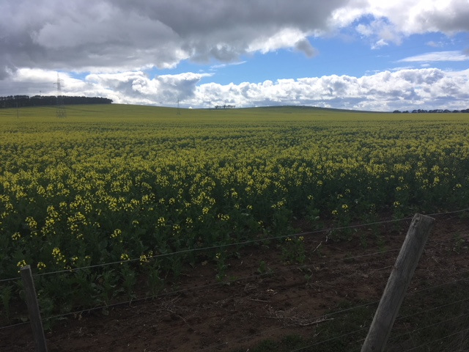

Slide 31
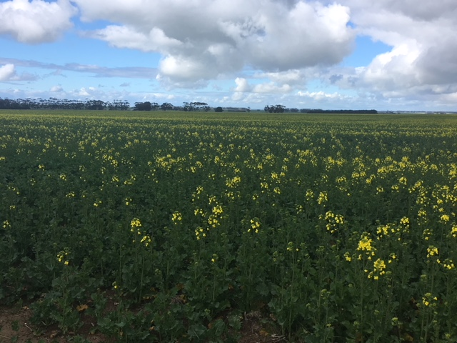

Slide 32
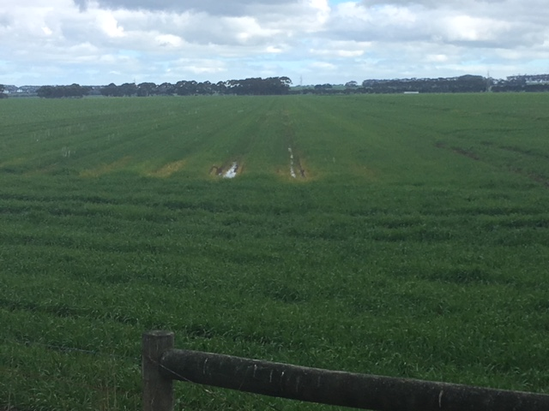

Slide 33
Comments
All intended areas for crop planted
Sowing from late April, through May.
Rainfall: Total YTD Lismore 344mm, of that 264mm has fallen in WD growing season (May-Aug). Annual average 610mm.
Lismore region full profile some water laying in raised bed rows
Crop conditions – crops in good health and well advanced.
Wheat – similar varieties to last year (30% Red/Feed– Revenue/Beaufort 70% Milling– Trojan/Bolac/Kiora/Kelallac)
Barley – Westminster dominant, some Planet, Latrobe, Gairdner, Compass planted.
Canola – both GM 20%/conventional 80% being grown

Slide 34
Comments
Selling – Growers haven’t committed large quantities new crop. Waiting to see if any upside to values. Also sentiment of frosting last year still in growers mind.
Straw will be baled up. Can’t envisage cereals being cut for hay unless there is an in crop issue/frost. Grain yields and prices will keep crops standing to be harvested.
Growers will cash grain, store some on farm to sell throughput the year.
Seasonal outlook for 2019 by the time harvest rolls around may change their view of cashing or warehousing.

