Slide 1
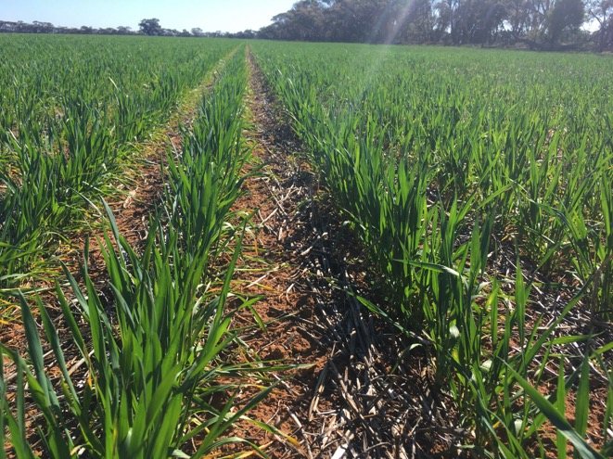
GIAV 2018 Annual Meeting Crop Outlook Panel

Slide 2
Crop Outlook Panel
Michelle Kerr Riordan Grain
Ian Wentworth JK Milling
Bill Donnellon Donnellon Bulk
Brad Cullen Emerald Grain
Richard Wilkens Wilken Storage
Peter Gerhardy Hanlon Enterprises

Slide 3
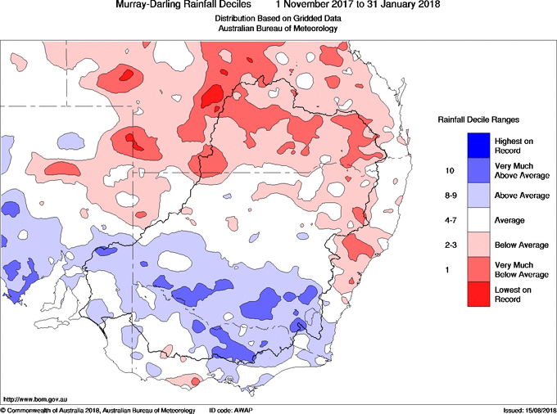
Rainfall Nov Dec Jan

Slide 4
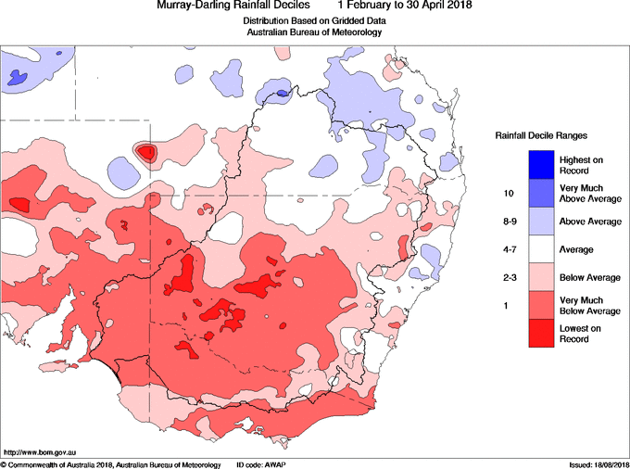
Rainfall Feb Mar Apr

Slide 5
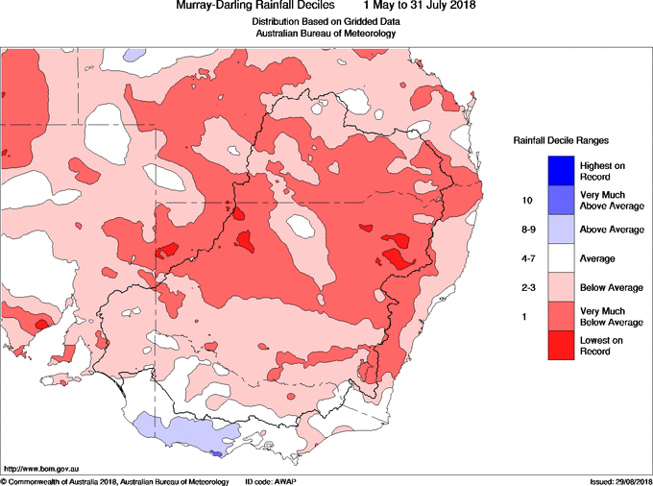
Rainfall May June July

Slide 6
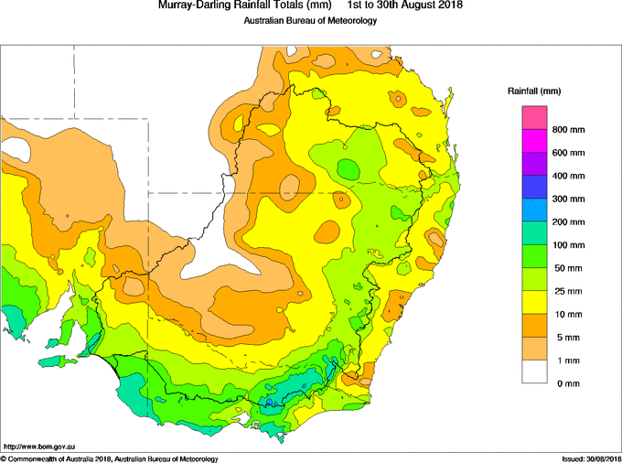
Rainfall Aug

Slide 7
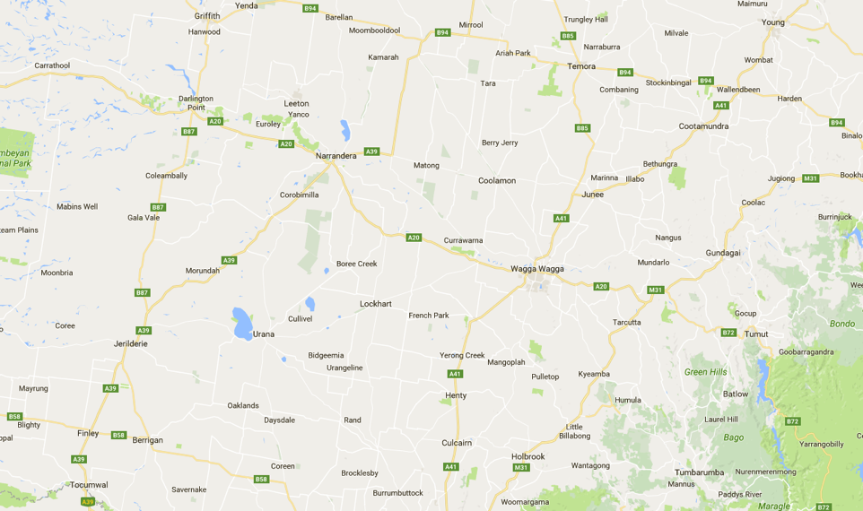
Southern Plains NSW

Slide 8
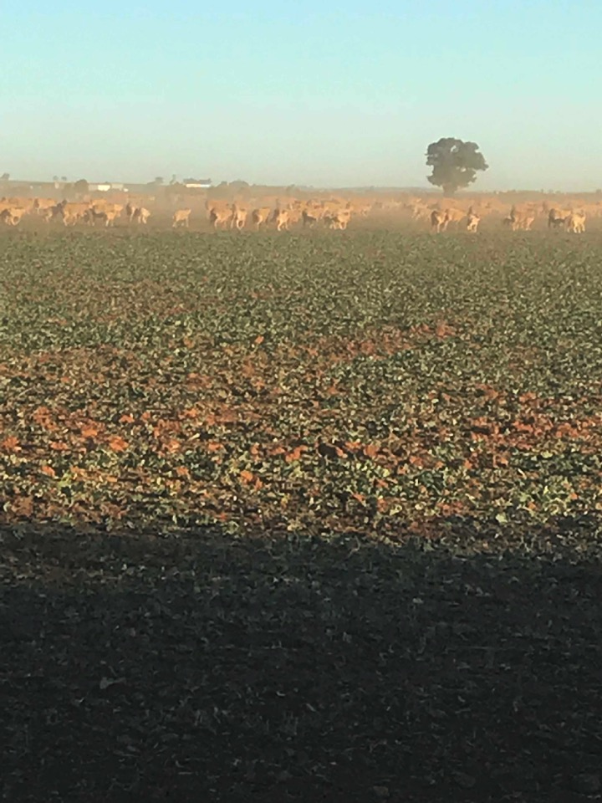

Slide 9
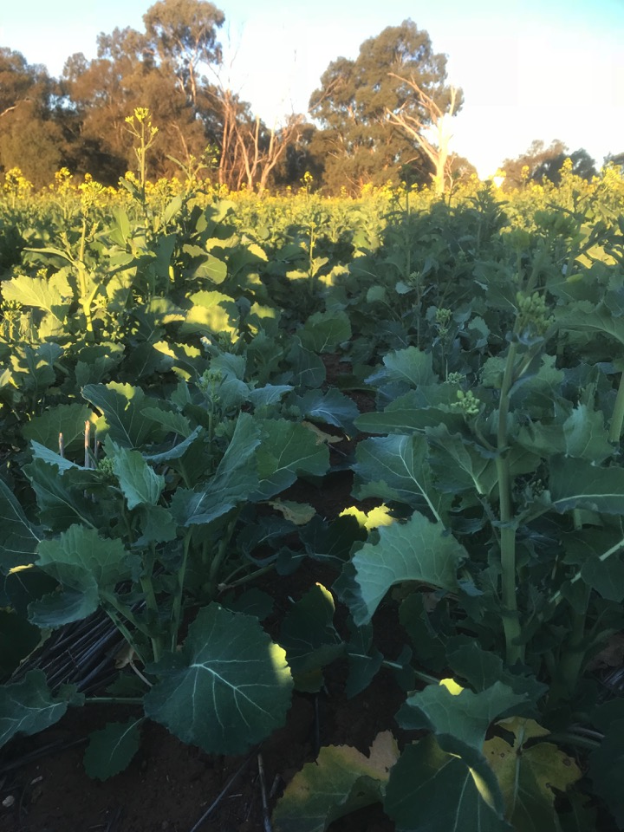

Slide 10
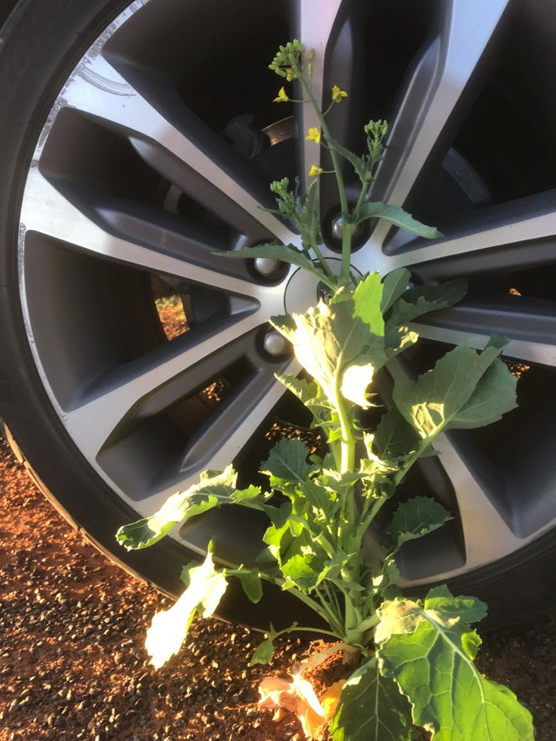

Slide 11
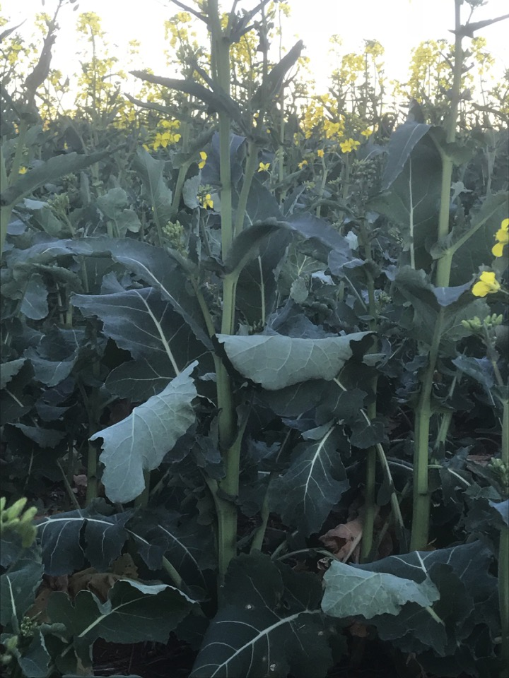

Slide 12
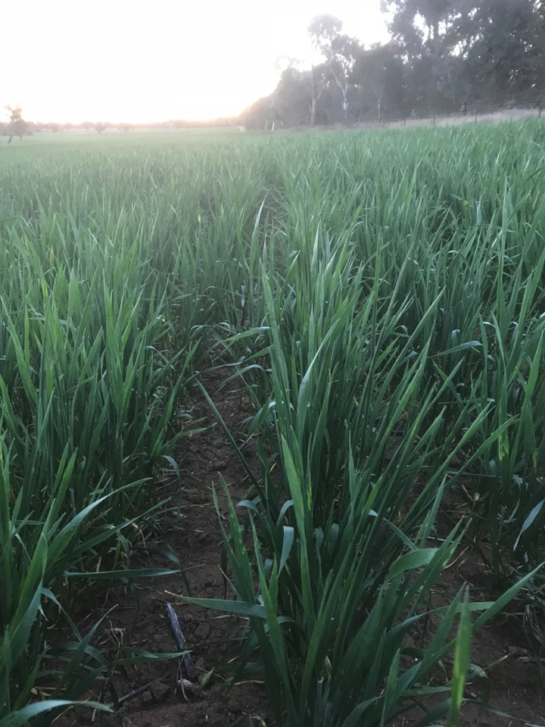

Slide 13
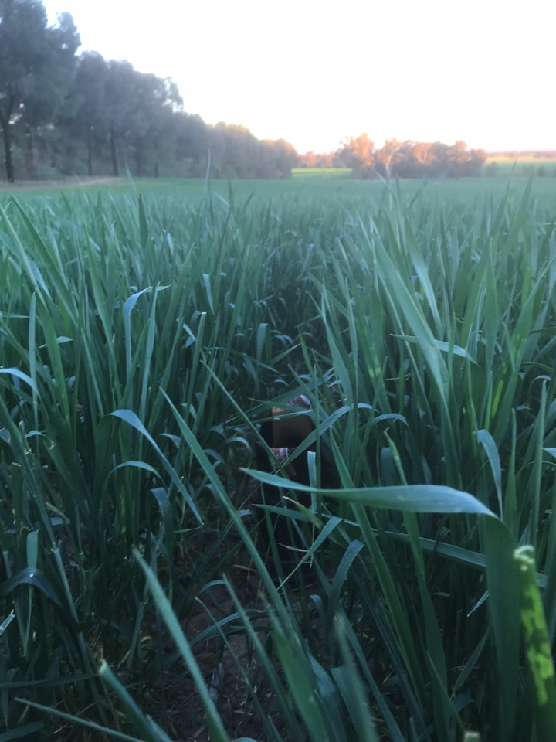

Slide 14
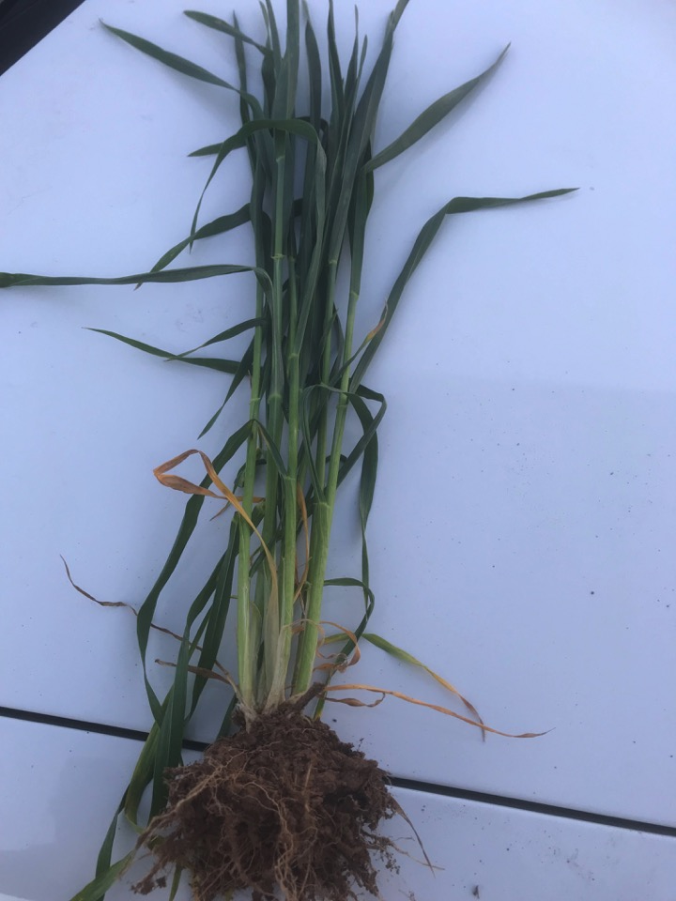

Slide 15
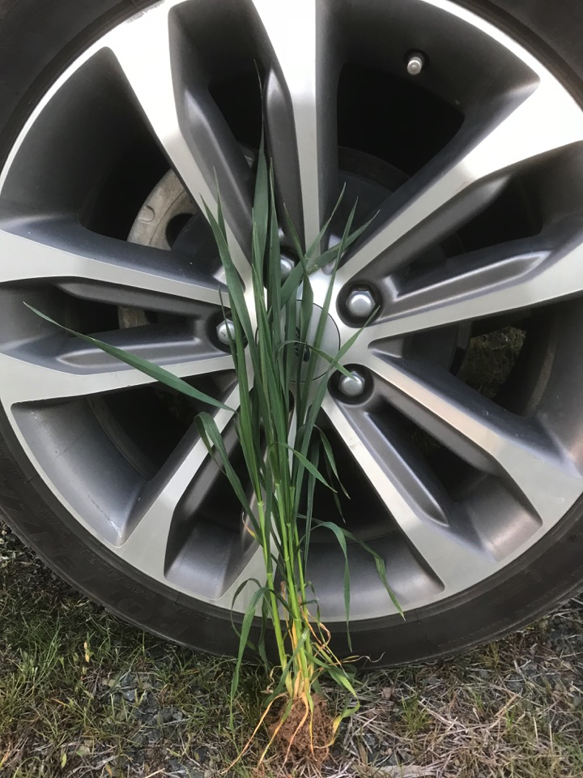

Slide 16
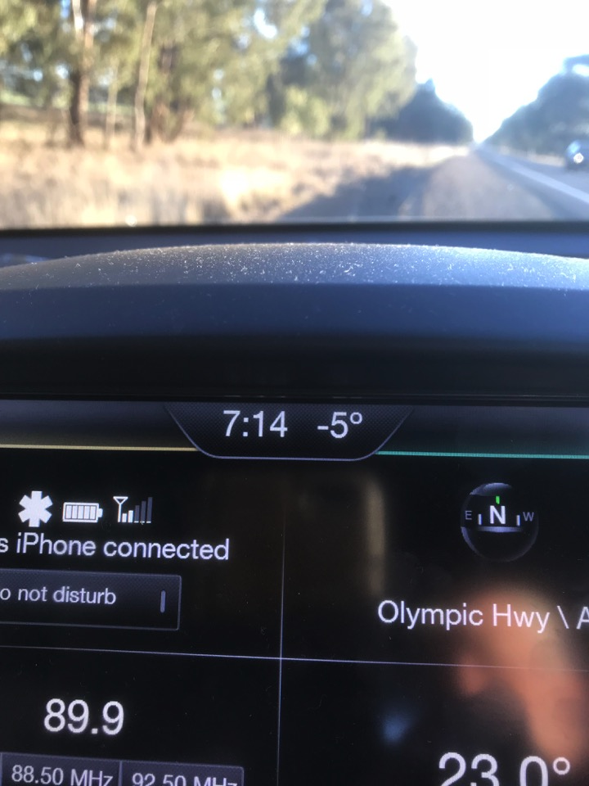

Slide 17
Comments
Rainfall figures from a grower 5kms west of Junee
Jan Feb Mar Apr May Jun Jul Aug Sept Oct Nov Dec
2017 19 48 79 52 46 6 49 54 9 56 50 113
2018 67 33 7 4 34 52 18 16
The growing period of April to Aug
2017 - 207mls after being planted on brilliant moisture
2018 - 128mls after being planted on virtually no top soil moisture

Slide 18
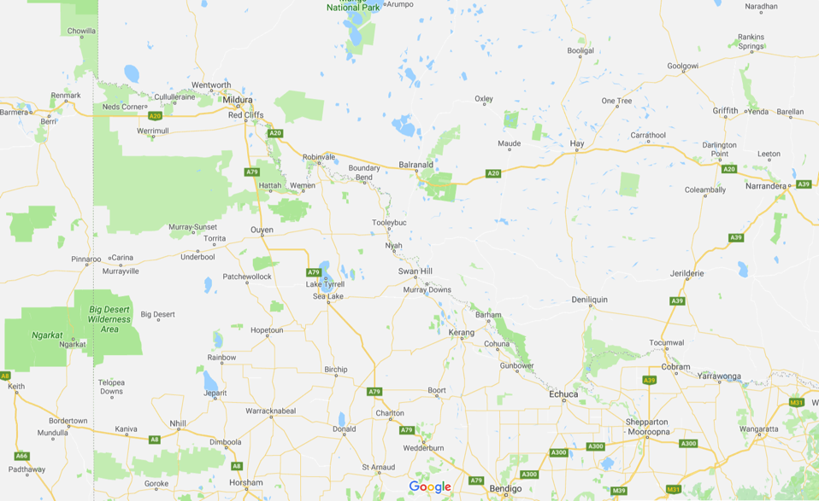
Northern Mallee

Slide 19
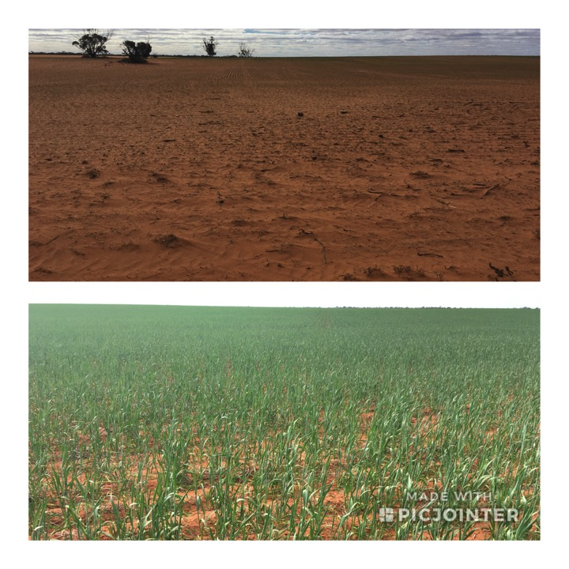

Slide 20
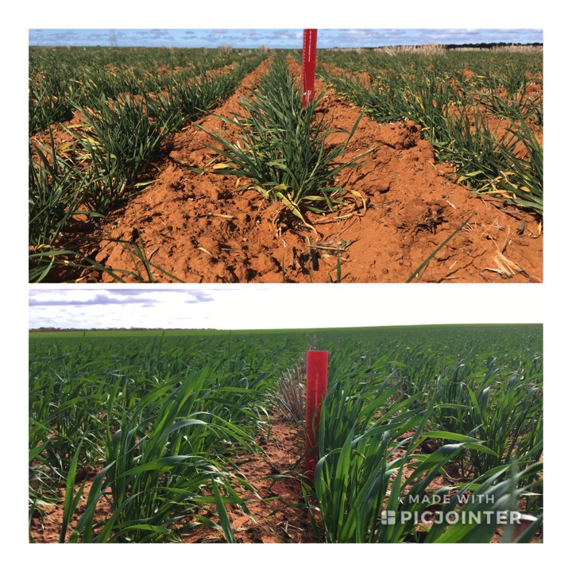

Slide 21
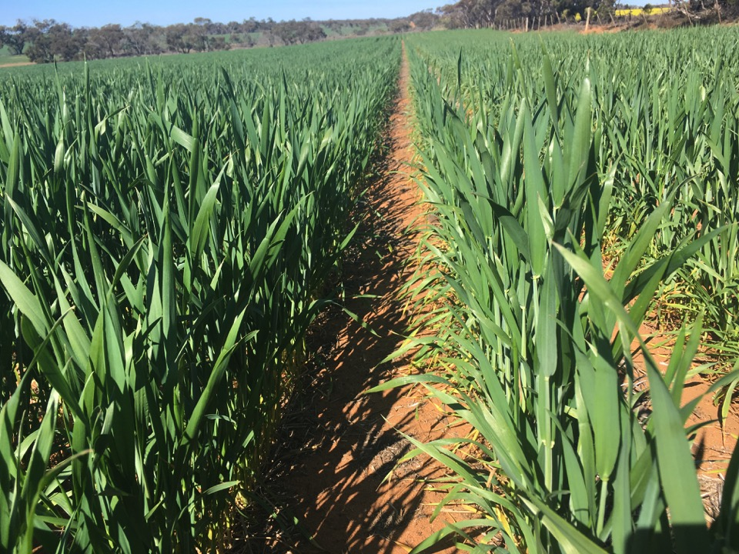

Slide 22
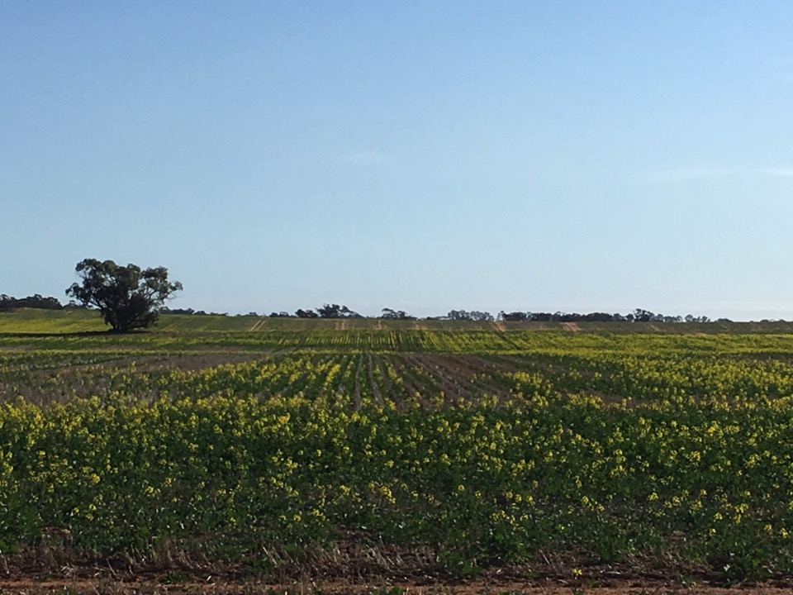

Slide 24
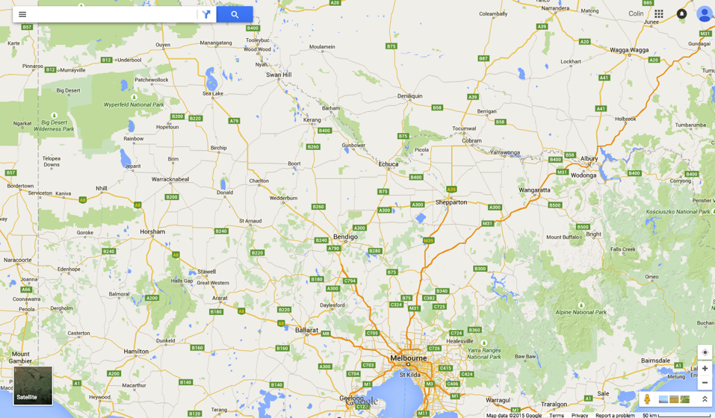
Southern Mallee

Slide 25
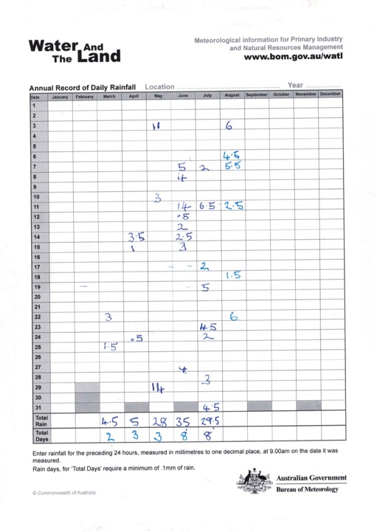

Slide 26
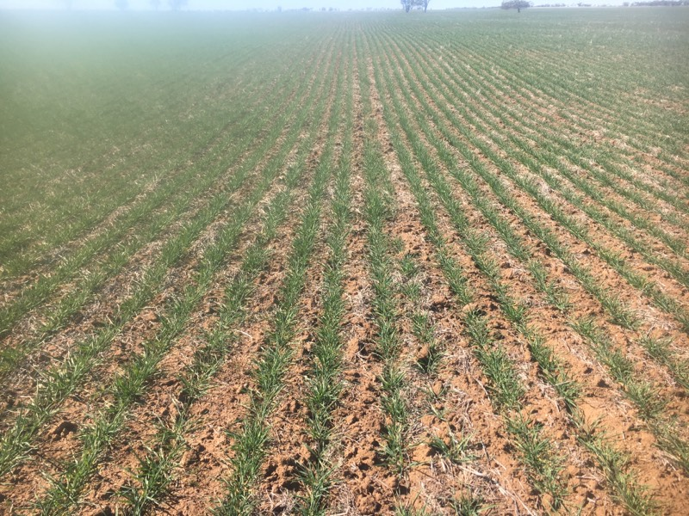

Slide 27
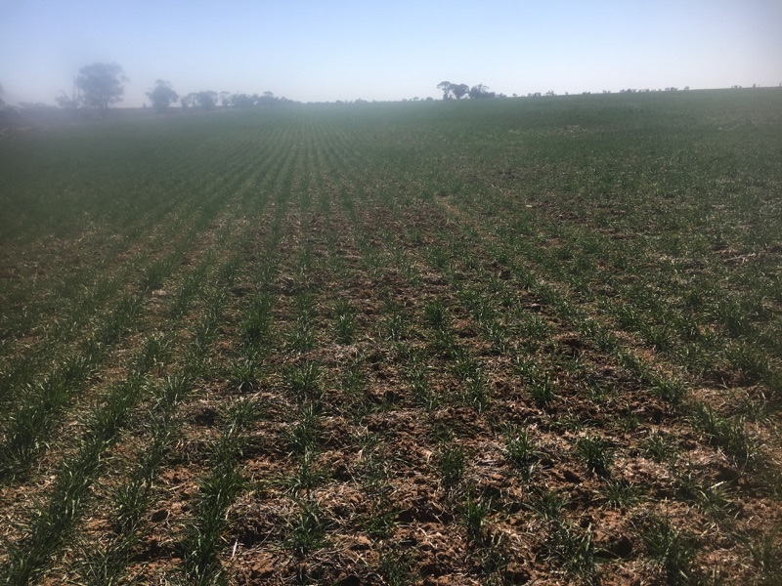

Slide 28
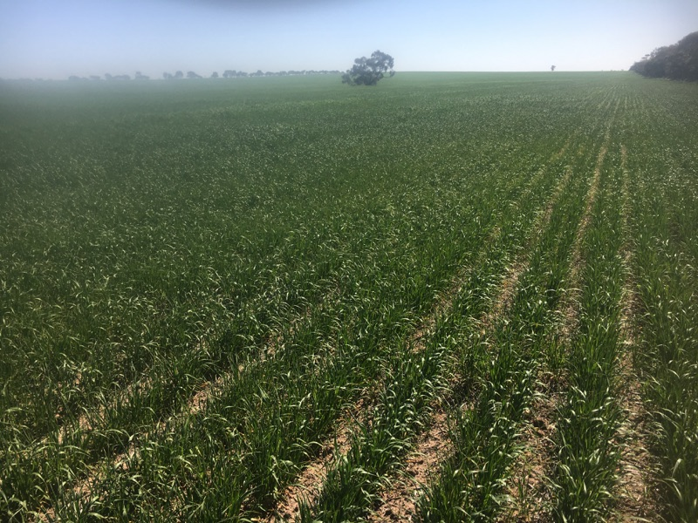

Slide 29
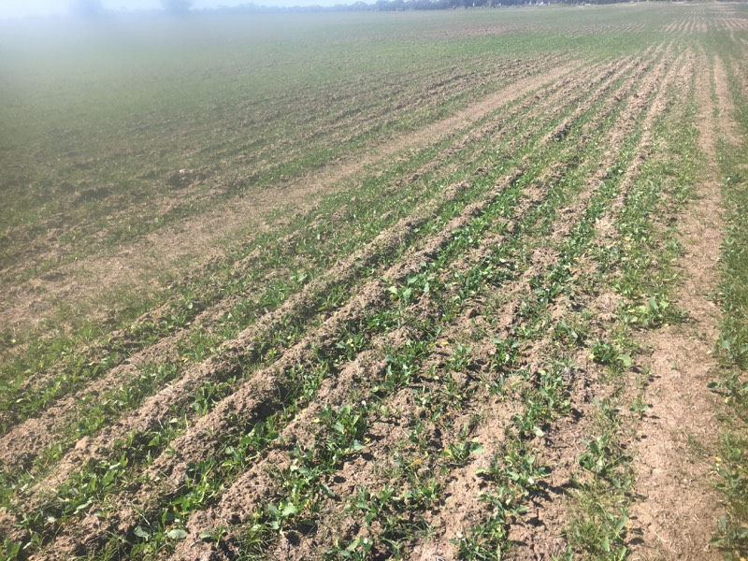

Slide 30
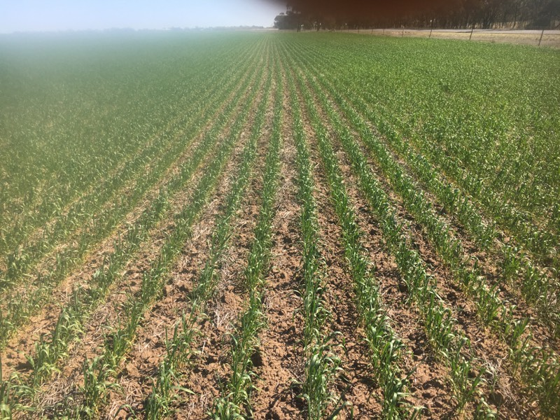

Slide 31
