Slide 1
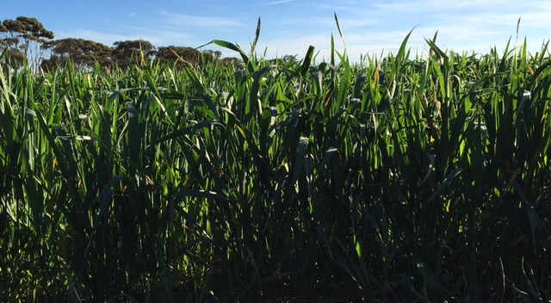
GIAV 2016 Annual Meeting Crop Outlook Panel Discussion

Slide 2
Crop Outlook Panel
Michelle Kerr Riordan Grain
James French Wimpak
Clayton Shannon Shannon Bros
Reagan Stroud Pearsons Group
David Barlow Jerilderie Grain S&H
Peter Gerhardy Hanlon Enterprises

Slide 3
Northern Mallee
Crop | Est’ area as % of total | Change from last year (% +/-) | Est ‘yield (t/ha)
Wheat | 48 | Similar | 2.3-2.8
Barley | 20 | tad less | 2.3-2.8
Canola | 2 | Similar | 1.3-1.8
Field Peas | 9 | Increase | 1.3-1.8
Lupins | 6 | Similar | 1.3-1.8
Vetch | 9 | Increase | N/A
Lentils | 6 | Increase | 1.3-1.8

Slide 4
Comments
Barley:
Main varieties Scope CL (60%) LaTrobe, Compass. Some Sparticus being bulked up (Scope replacement) and Hindmarsh area well down.
Booting to early head development
Wheat:
Main varieties Kord CL (40%) Mace, Scout, Grenade.
Early maturing varieties (Kord/Mace) at boot stage.
Other:
Cereal development well advanced with slightly warmer winter temps and greater % of early maturing varieties sown early – some indicating 3 weeks early. Poses consideration to frost risk. Yield ranges up to 4-4.5t/ha
Clearfield varieties favoured to manage brome grass and herbicide residue issues arising from low summer rains.

Slide 5
Nitrogen use significant this year at higher rates – 50-150kg
Increases to legumes at expense of chemical fallow. Lentil sowings were reportedly limited by seed availability.
Crop management herein to focus on fungicide application and pests (aphids if app.)

Slide 6
Rainfall
 | 2016 |  | 2015
 | YTD total | May-Aug | YTD total | May-Aug
Ouyen | 195 | 139 | 159 | 85
Mildura | 175 | 104 | 218 | 68
Swan Hill | 207 | 132 | 135 | 94
Balranald | 253 | 182 | 209 | 87
Manangatang | 194 | 142 | 113 | 66
Generally 40-60mm YTD more rain with exception of Mildura
60-70% of rainfall has been Mar-Aug vs 40% equivalent period last year, hence crop condition is very good-excellent
Soil moisture – no substantial sub soil moisture profile given a dry summer and end to 2015. “Poorer” regions are reportedly in far NW with crop conditions improving following August rain
Need spring rains to finish and realize potential, no “safety net” in the moisture profile.

Slide 7
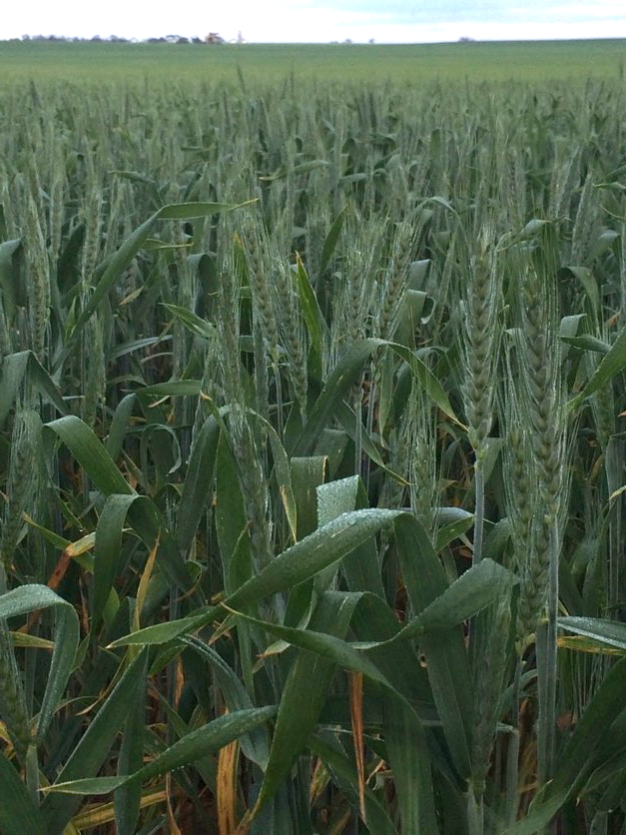

Slide 8
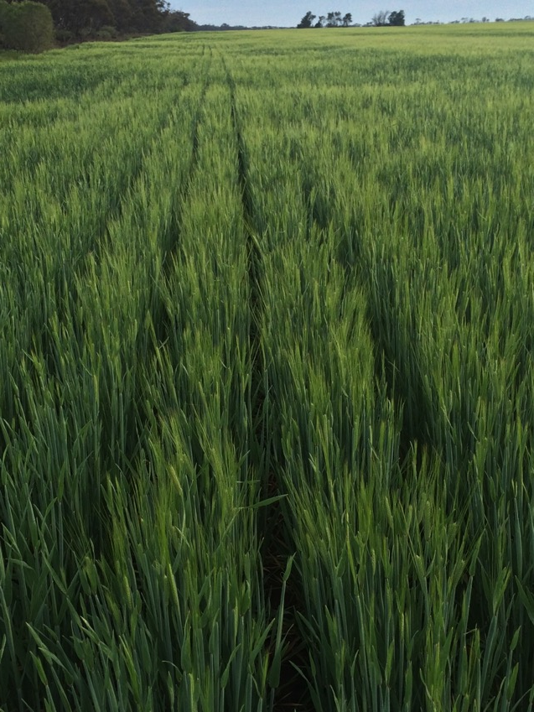

Slide 11
Southern Riverina
David Barlow – 0428 262198
Jeremy Barlow – 0428 262197
6030 Newell Highway, Jerilderie NSW 2716

Slide 12
Southern Riverina
Crop | Est’ area as % of total | Change from last year (% +/-) | Est ‘yield (mt/ha)
Wheat | 50 | +6 | 3.0
Barley | 25 | 0 | 2.5
Oats | 2 | 0 | 3.0
Canola | 20 | -13 | 1.5
Lentils | 0 | 0
Field Peas | 1 | 0
Chick Pea | 0 | 0
Faba Bean | 1 | 0
Lupins | 1 | 0
Murrumbidgee River south to Murray River
Coleambally to Tocumwal (Murray River)
Deniliquin east to Corowa and Wagga

Slide 13
Wheat Crop
Soil moisture

Slide 14
Wheat Crop
Foliate diseases
Insects, pests

Slide 15
Wheat and Canola
Was once used for sheep grazing
Internal fences pulled down
big cropping paddocks

Slide 16
Barley Crop
Difficult to know what variety to grow
Mixed messages from barley breeders, maltsters and seed distributors

Slide 17
Canola crop
Foliate diseases
mosquitoes

Slide 18
Urea
Urea applied

Slide 19
Irrigation
Only water when required

Slide 20
Canola
Loading canola from Jerilderie Grain Storage & Handling Silos

Slide 21
Harvest

Slide 22
Silos
Sealed Storage Silos

Slide 23
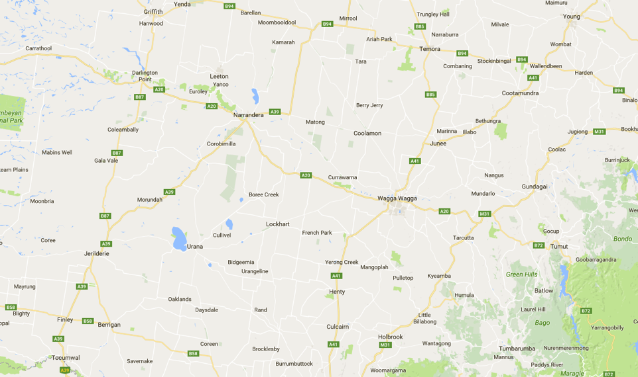
Southern Plains NSW
2
3
1

Slide 24
Lockhart / Boree Ck / The Rock
Crop | Est’ area as % of total | Change from last year (% +/-) | Est ‘yield (mt/ha)
Wheat | 40 | + | 2.3 – 5.0
Barley | 17 | - | 3.0
Oats | 2 | +
Canola | 25 | + | 1.2 – 1.6
Field Peas | 2
Chick Peas | 1 | +
Faba Bean | 5 | -
Lupins | 8

Slide 25
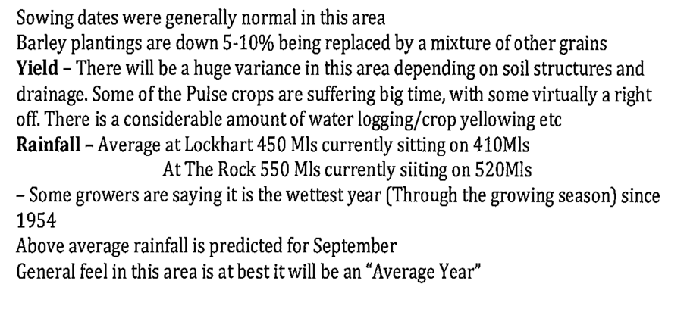
Comments

Slide 26
Coolamon / Junee / Temora
Crop | Est’ area as % of total | Change from last year (% +/-) | Est ‘yield (mt/ha)
Wheat | 45 | + | 2.4-5.0
Barley | 15 | - | 2.5-4.0
Oats | 3 | +
Canola | 26 | + | 1.0-2.5
Field Peas | 3 | +
Chick Peas | 1 | +
Faba Bean | 1 | -
Lupins | 6 | +

Slide 27
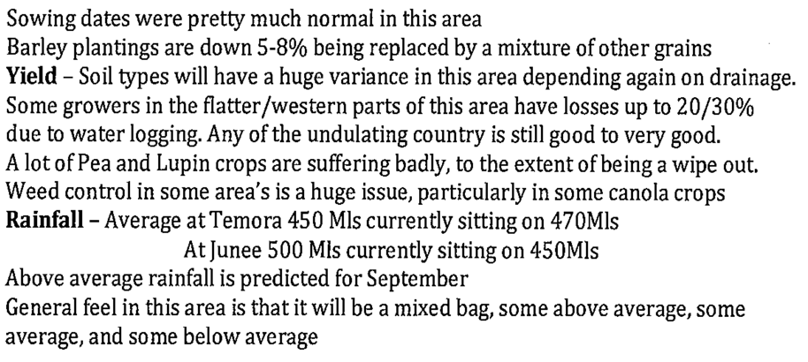
Comments

Slide 28
Harden / Cootamundra
Crop | Est’ area as % of total | Change from last year (% +/-) | Est ‘yield (mt/ha)
Wheat | 50 | + | 4.0-5.0
Barley | 5 |  | 3.0-4.0
Oats | 2
Canola | 38 | - | 2.0-2.5
Field Peas | 1
Lupins | 4 | +

Slide 29
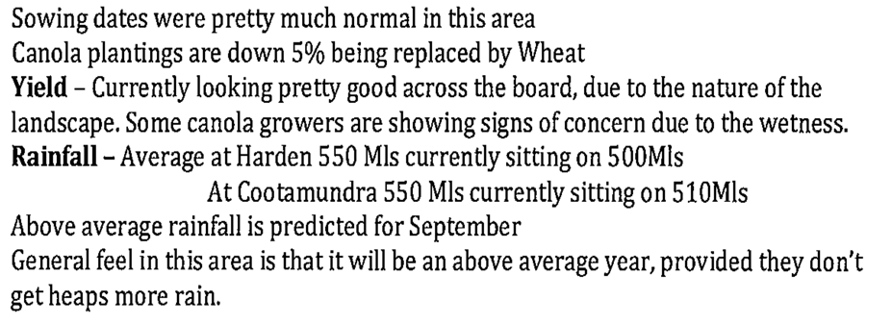
Comments

