Slide 1
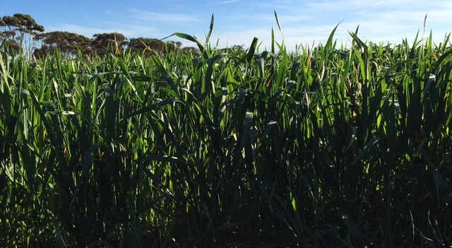
GIAV 2016 Annual Meeting Crop Outlook Panel Discussion

Slide 2
Crop Outlook Panel
Michelle Kerr Riordan Grain
James French Wimpak
Clayton Shannon Shannon Bros
Reagan Stroud Pearsons Group
David Barlow Jerilderie Grain S&H
Peter Gerhardy Hanlon Enterprises

Slide 3
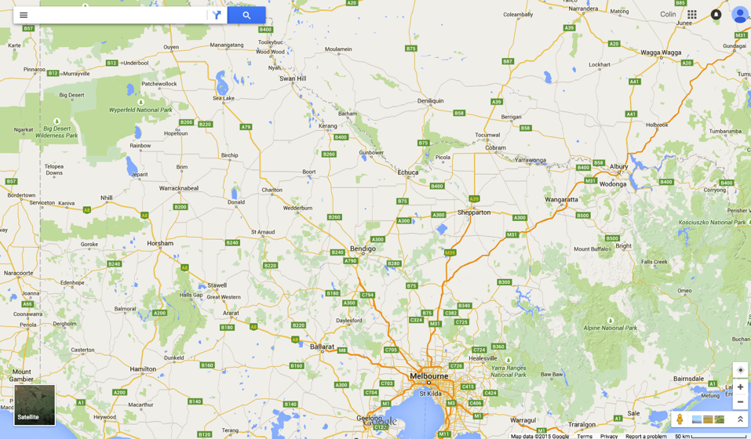
Regions Considered

Slide 4
Western District – West and East
Crop | West Area % of total | West (% +/-) | West (mt/ha) | East % of total | West (% +/-) | East (mt/ha)
Wheat | 45 | +6 | 6.0 | 40 | 7 | 4.0
Barley | 25 | +3 | 5.0 | 25 | -1 | 4.0
Oats | 3 | +1
Canola | 20 | -7 | 2.5 | 25 | -7 | 2.0
Field Pea |  |  |  | 5 | 0
Fabas | 7 | -3 | 3.0 | 5 | 1 | 2.5

Slide 5
Comments
Rainfall: Total YTD Lismore 450mm, of that 350mm fell in growing season (April-Aug). Annual average rainfall 610mm.
Rainfall: Total YTD Balliang: 250mm, of that 196mm fell in growing season (April-Aug). Annual average rainfall 475mm.
All WD has a full moisture profile & good run off some areas can take more rain any time!
Barley – Main variety Westminster. Very little Gairdner grown now. Some are also growing Scope and Compass.
Wheat – various varieties sown, red wheat (Revenue/Beaufort) and white wheats (Derrimut/Trojan/Bolac/Kiora).
Canola – Both GM and Non GM grown most sown end April.
Early crops looking better than later sown
WD crops being sown early in line with Wimmera

Slide 6
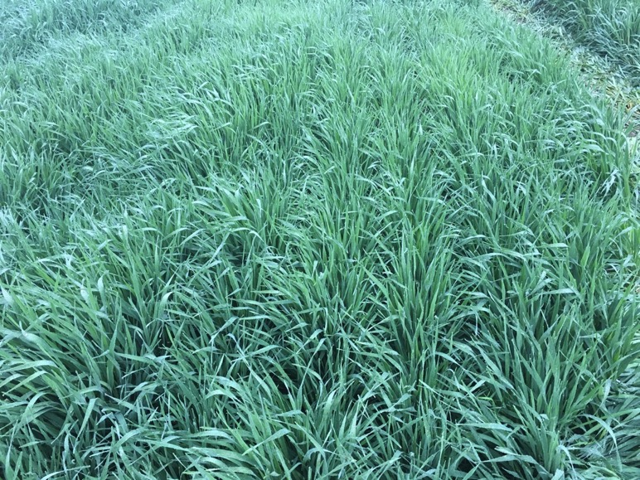
Compass barley- Balliang

Slide 7
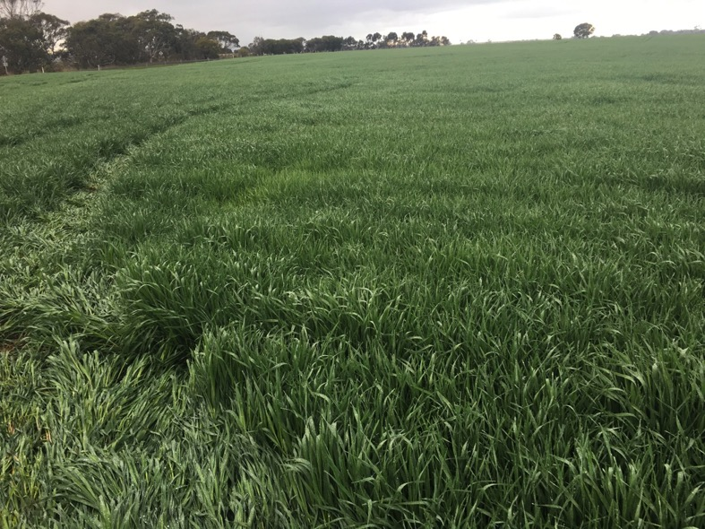
Compass barley- Balliang

Slide 8
Cressy Canola

Slide 9
Cressy wheat

Slide 10
Derrimut - Balliang

Slide 11
Derrimut

Slide 12
Scope - Balliang

Slide 13
Scope - Balliang

Slide 14
Wheat - Balliang

Slide 15
Wheat - Balliang

Slide 16
Wimmera – Warracknabeal - Stawell
Crop | Est’ area as % of total | Change from last year (% +/-) | Est ‘yield (mt/ha)
Wheat | 20 | -8 | 305
Barley | 30 | -3 | 4.0
Oats | 6 | *10 | 3.0
Canola | 8 | 0 | 2.2
Lentils | 20 | 10 | 2.0
Field Peas | 3 | 0 | 2.0
Chick Pea | 5 | 1 | 1.8
Faba Bean | 7 | 2 | 2.2
Lupins | 1 | 0 | 2.0

Slide 17
Wimmera Comments
*Oats for grain – oats for hay relatively unchanged.
Yield estimates based on average GSR & weather conditions for balance of growing season, bias to upside
estimated current soil moisture profile is 60% of field capacity

Slide 18
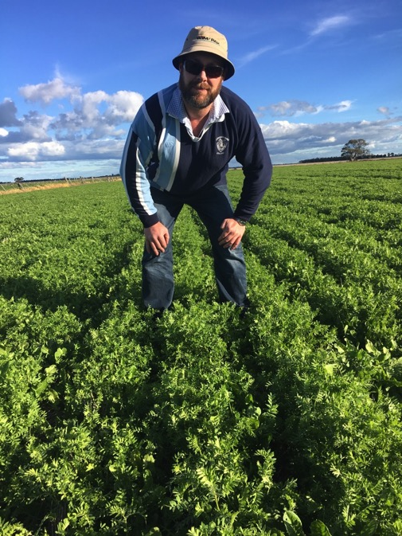

Slide 19
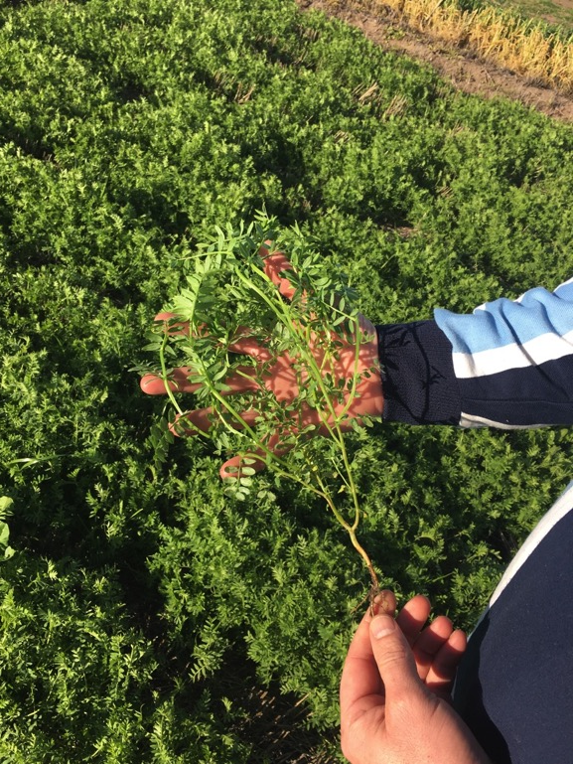

Slide 20
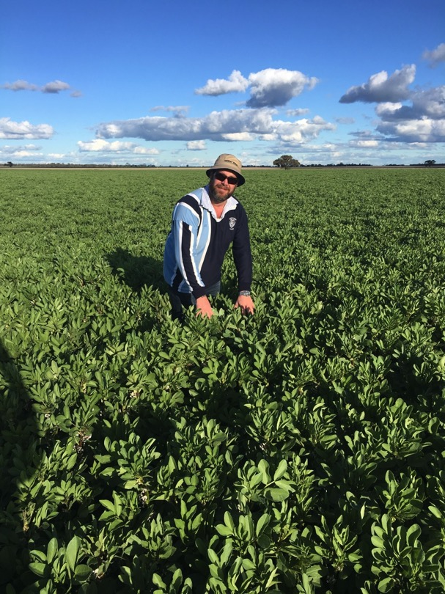

Slide 21
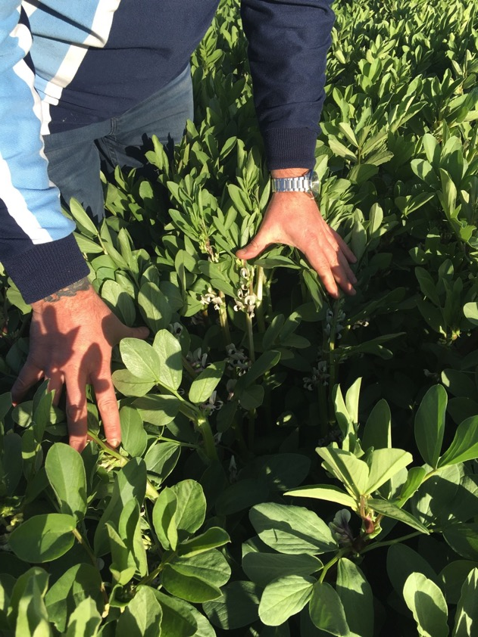

Slide 22
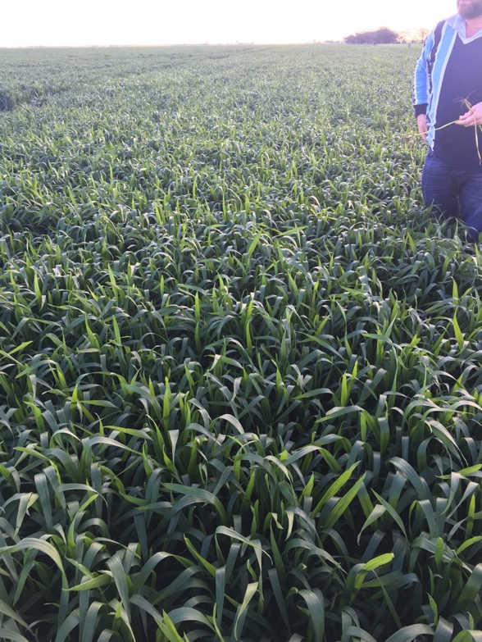

Slide 23
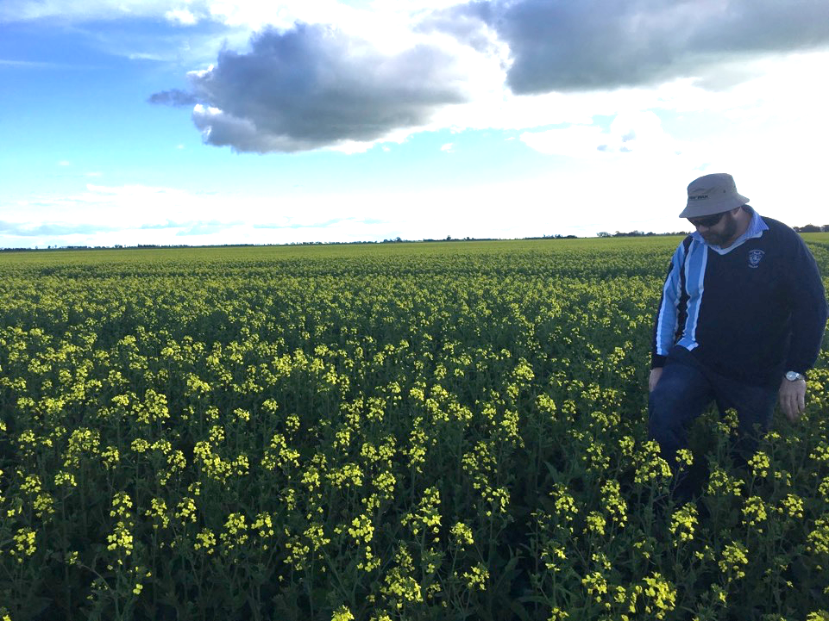

Slide 24
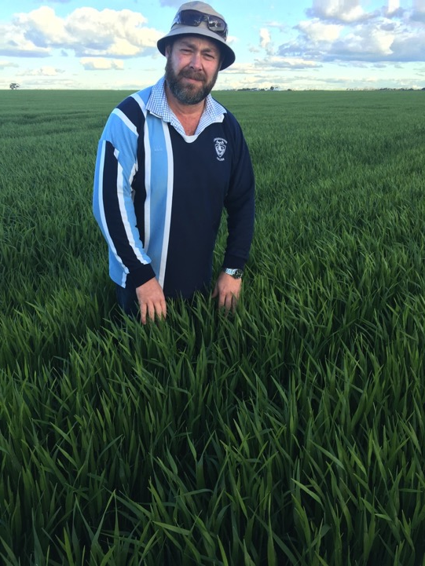

Slide 25
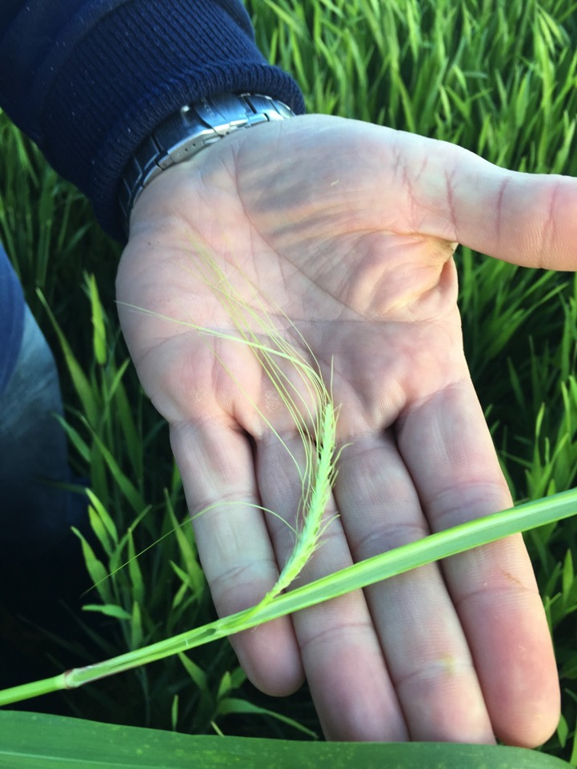

Slide 26
Southern Mallee – Patchewollock-Warracknabeal
Crop | Est’ area as % of total | Change from last year (% +/-) | Est ‘yield (mt/ha)
Wheat | 30 |  | 2.7
Barley | 40 |  | 3.0
Oats | 1 |  | 2.0
Canola | 2 |  | 1.2
Lentils | 25 |  | 1.2
Field Peas | 1 |  | 1.0
Lupins | 1 |  | 1.0

Slide 27
Beulah Rainfall
Jan – 46mm
Mar – 11mm
Apr – 1.5mm
May – 63mm
Jun – 36.5mm
Jul – 46
Aug – 25mm
Growers seem to be hoping that lentils in particular will meet their early cash flow needs.

